Slide 1
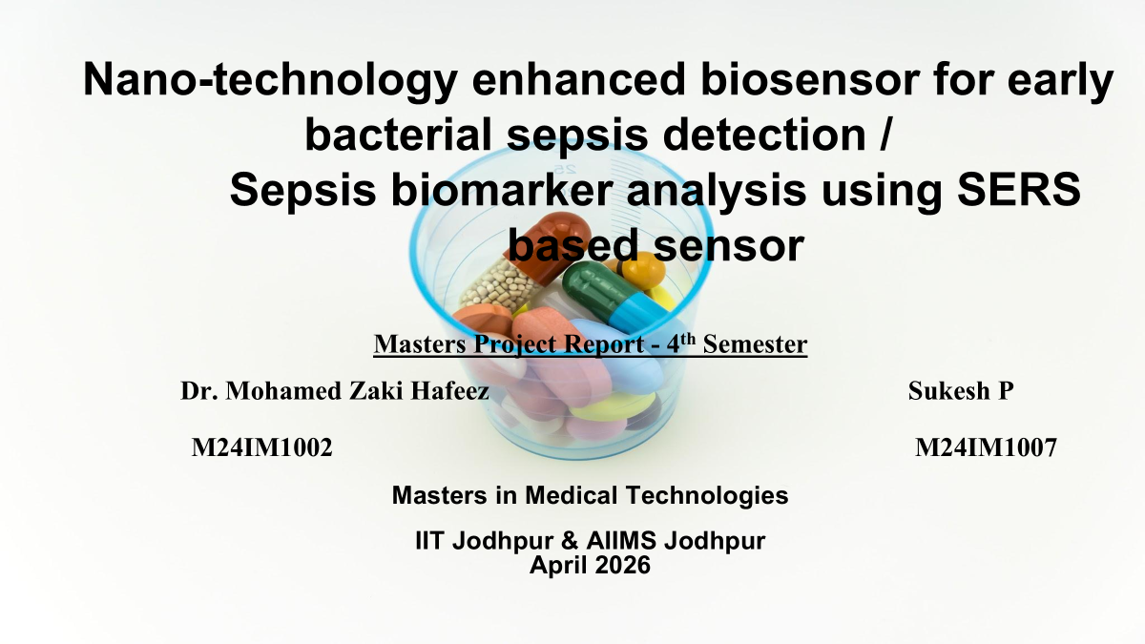
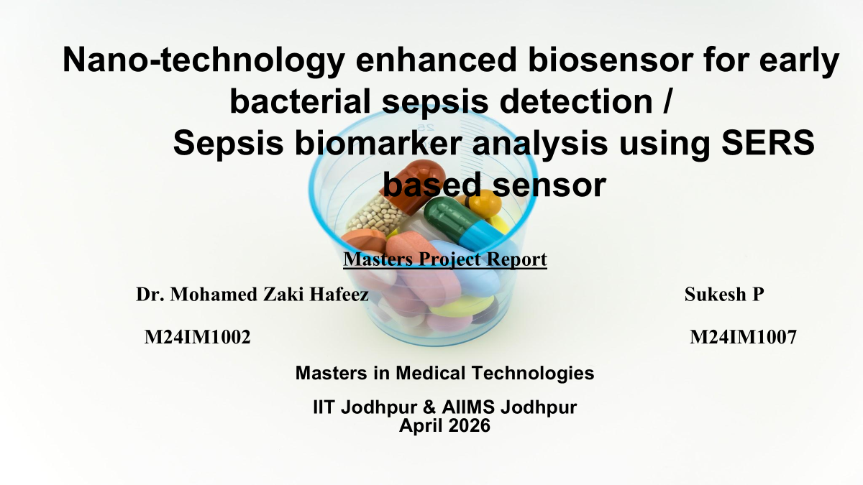

Slide 2


Slide 3


Slide 4
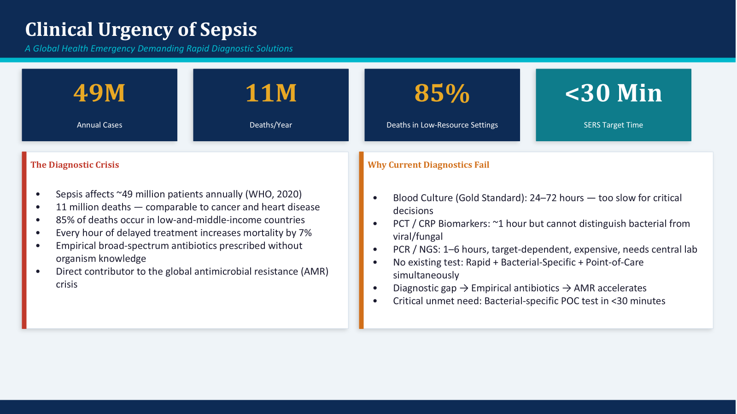

Slide 5
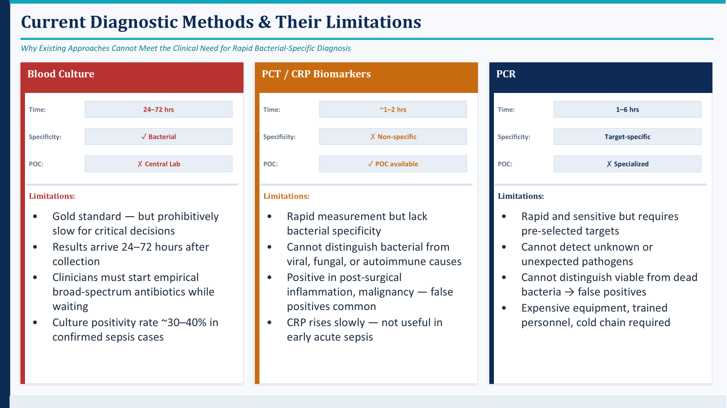

Slide 6


Slide 7
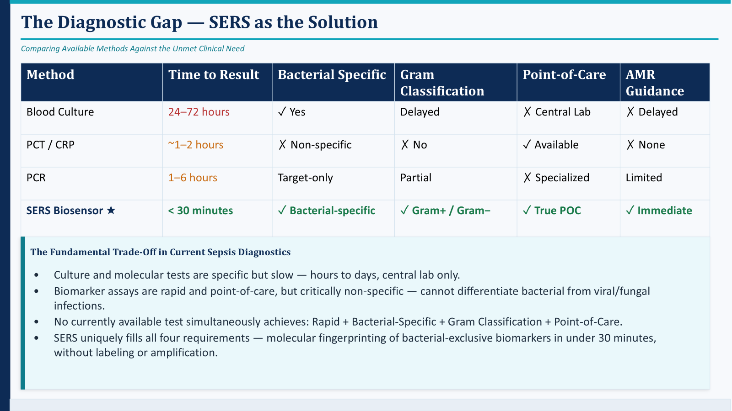

Slide 8
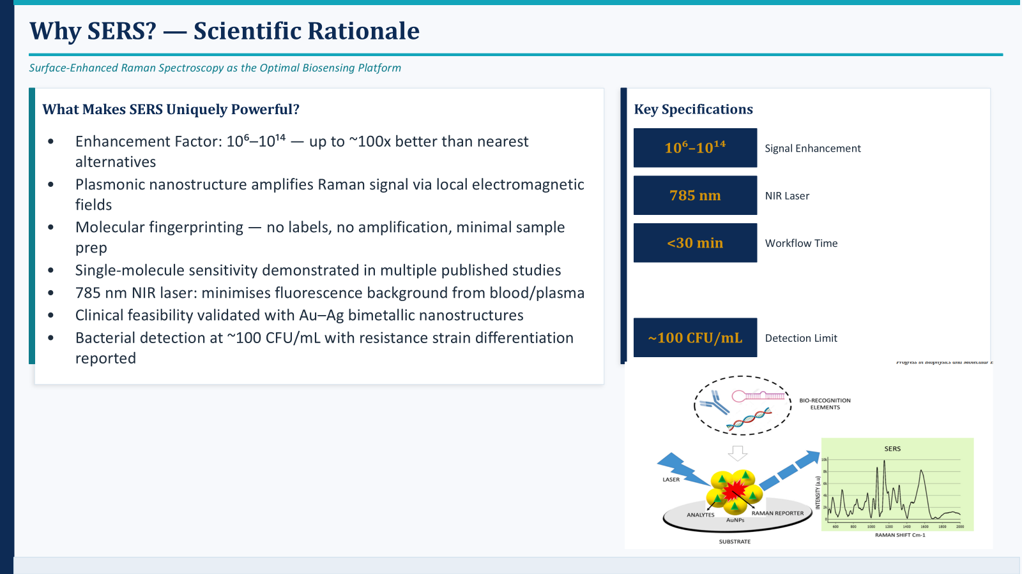

Slide 9
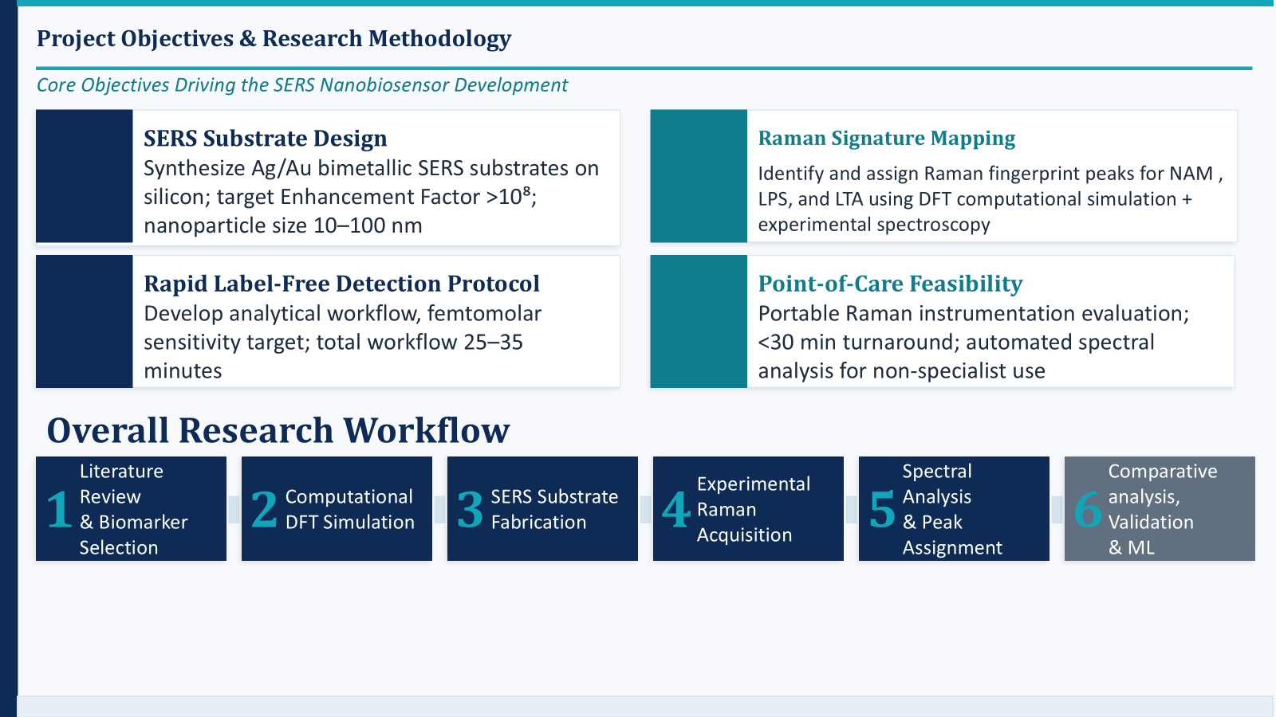

Slide 10


Slide 11
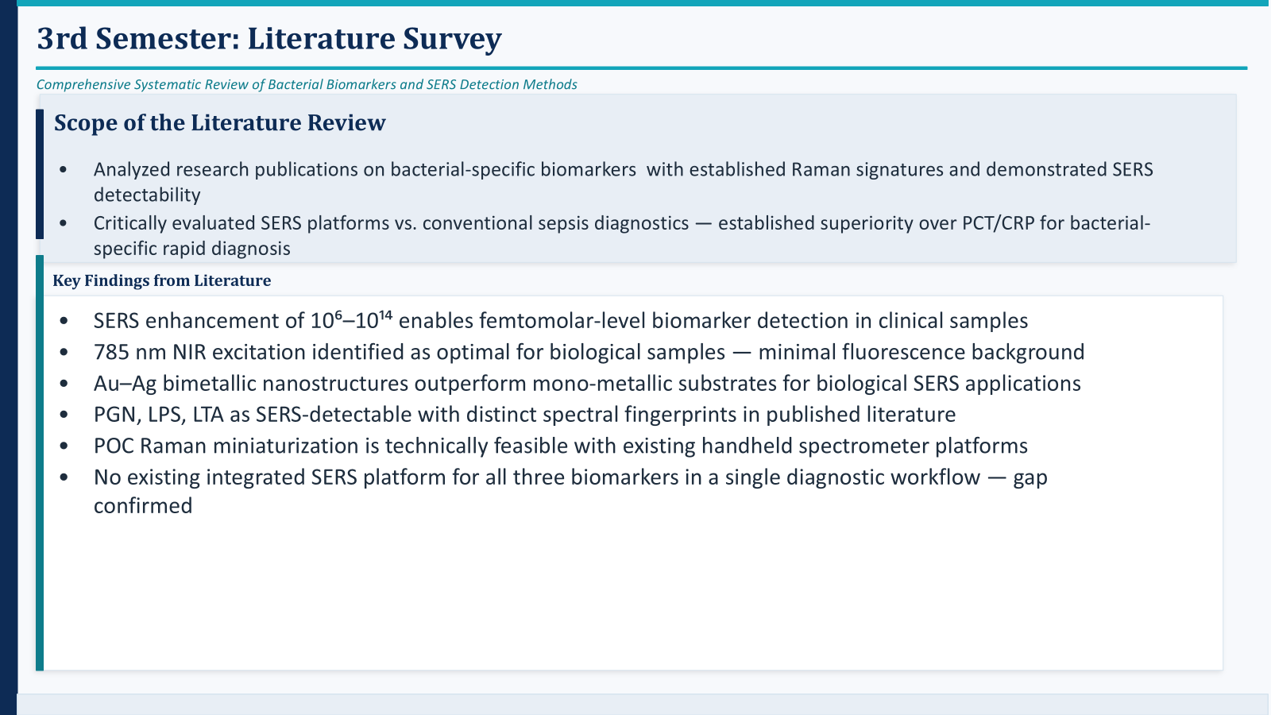

Slide 12
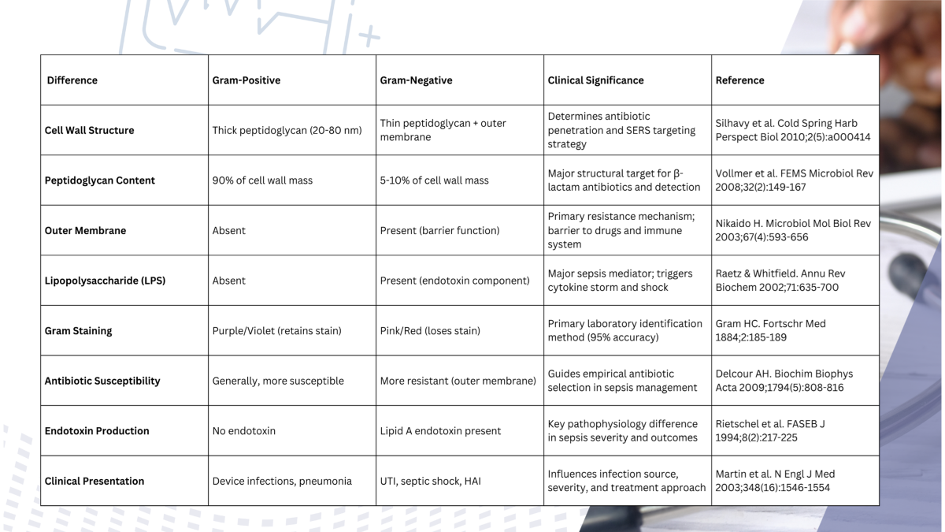
Differences between Gram Positive and Gram negative Bacteria

Slide 13
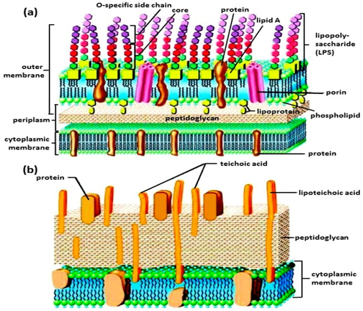
Diagram representation of
a)LPS & b) LTA

Slide 14
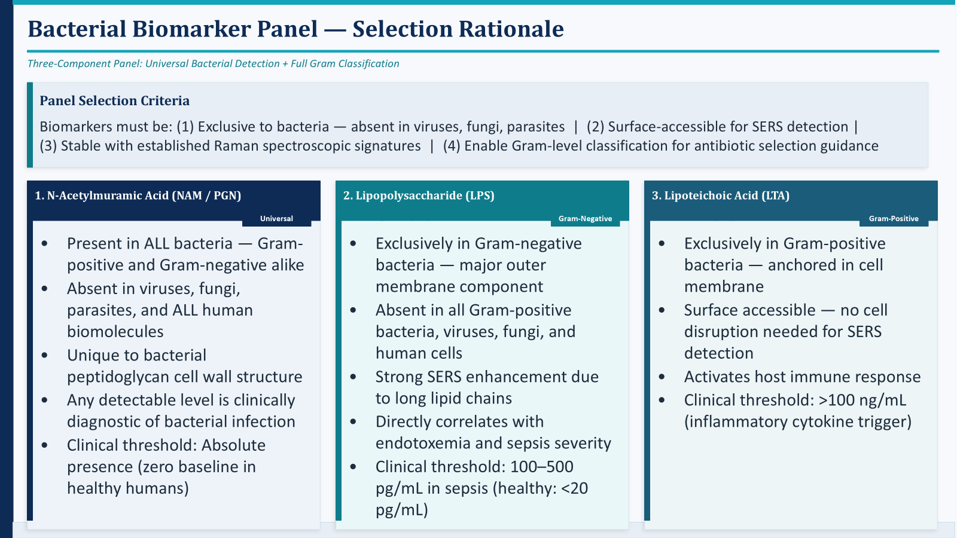

Slide 15


Slide 16
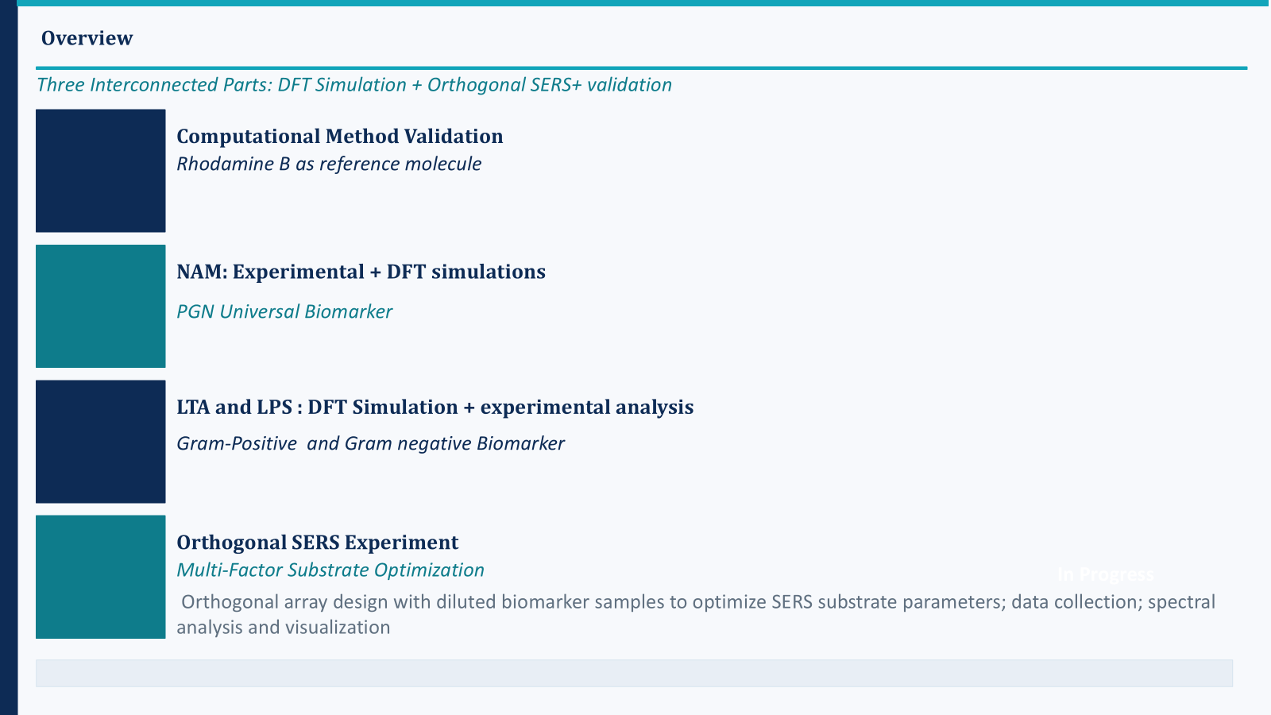

Slide 17
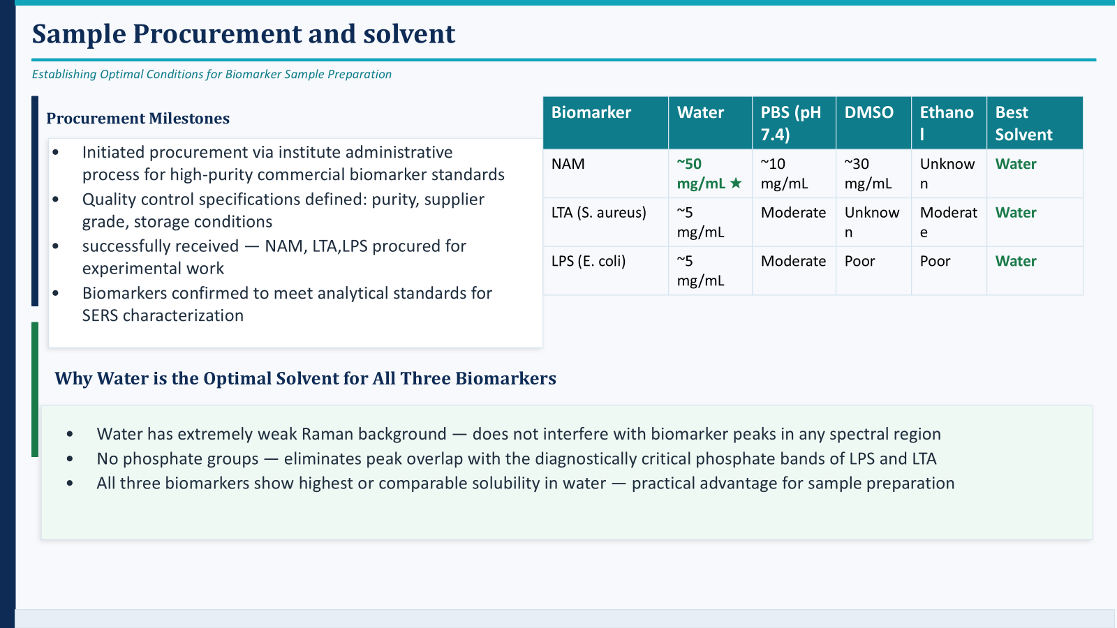

Slide 18
Software & Computational Setup
Gaussian 16 software procured and installed
Computational environment configured
Training & Skill Development
Attended training on Gaussian and DFT simulations
Learned molecular modeling and vibrational analysis

Slide 19
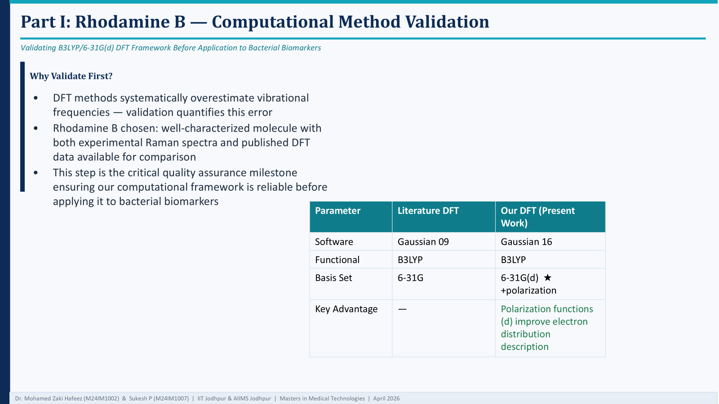

Slide 20
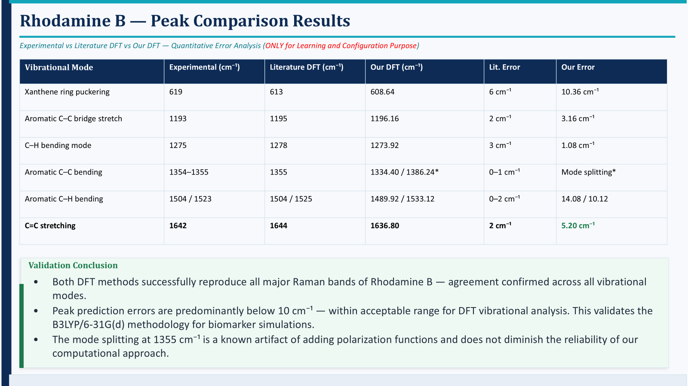

Slide 21
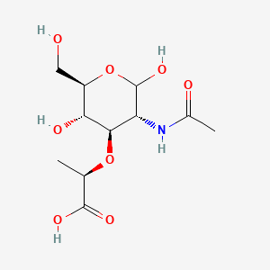
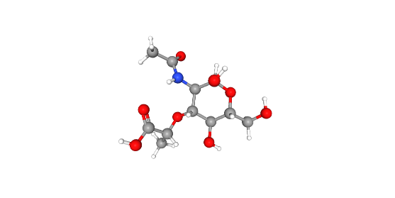
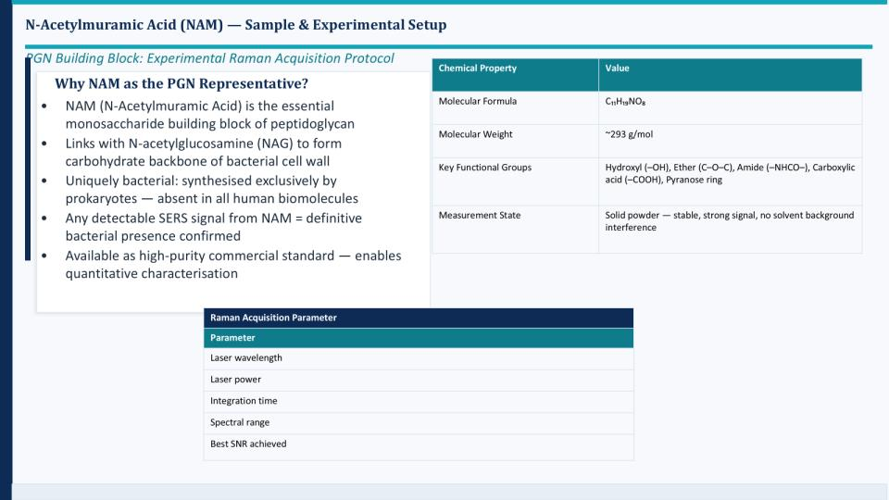
Raman–DFT Analysis of N-Acetylmuramic Acid (NAM)
2D Structure
3D Structure

Slide 22
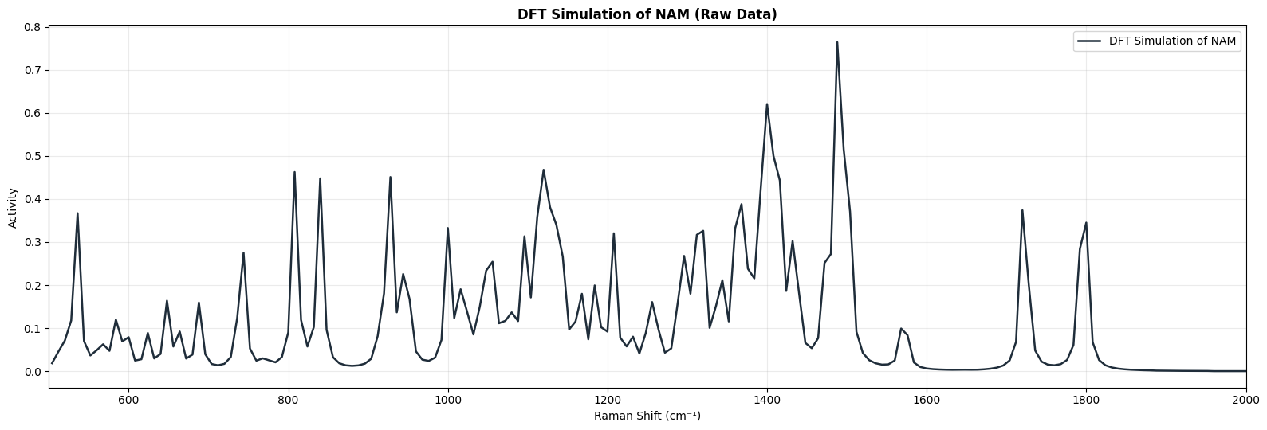
Raman Measurement
DFT Simulation Parameters (NAM)
Software: Gaussian 16
Method: B3LYP / 6-31+G(d,p)
Calculation: Opt (Tight) + Freq (Raman)
Geometry: Connectivity defined
Resources: 16 cores, 56 GB RAM
Parameter | Range
Laser wavelength | 785 nm
Laser power | 10–80 %
Integration time | 10–25 s
Spectral range | 200–3000 cm⁻¹
Raman Data Processing
Spectra were preprocessed before analysis.
Processing pipeline:
Dark subtraction
Savitzky–Golay smoothing
Baseline correction (ALS)
Normalization
Peak detection
SNR calculation

Slide 23
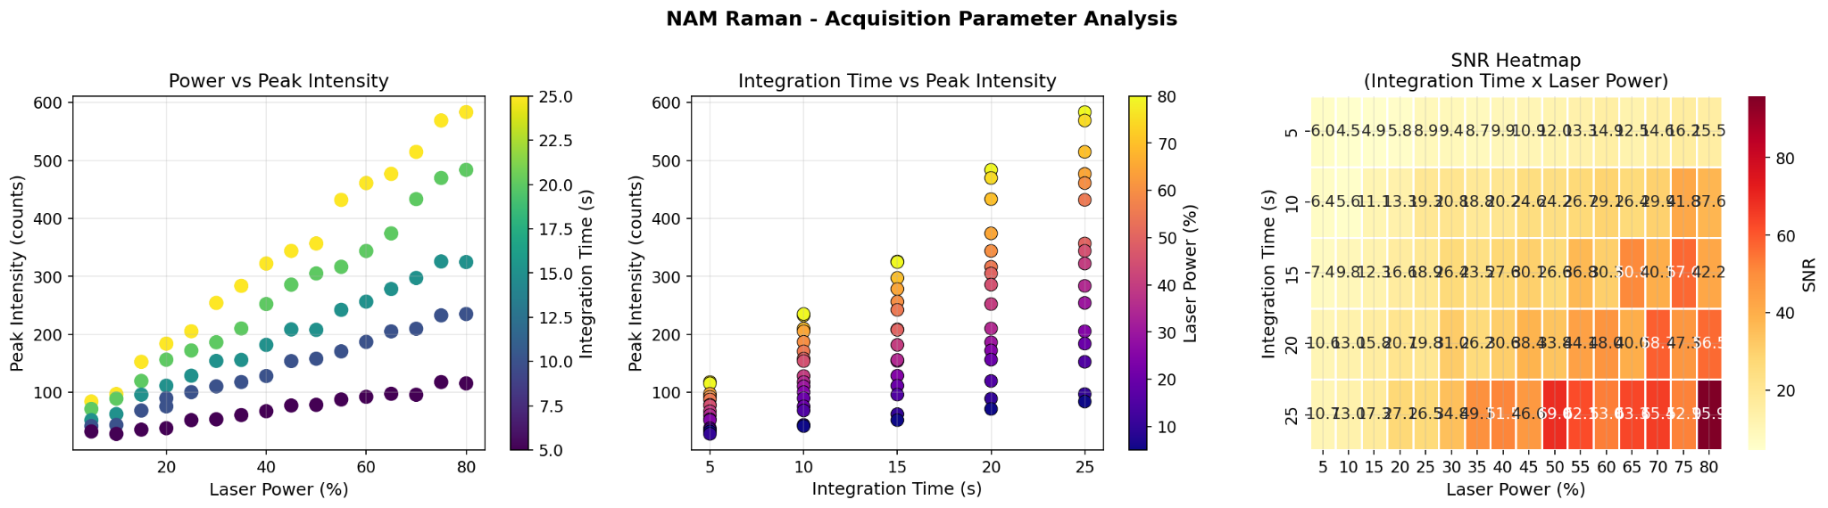
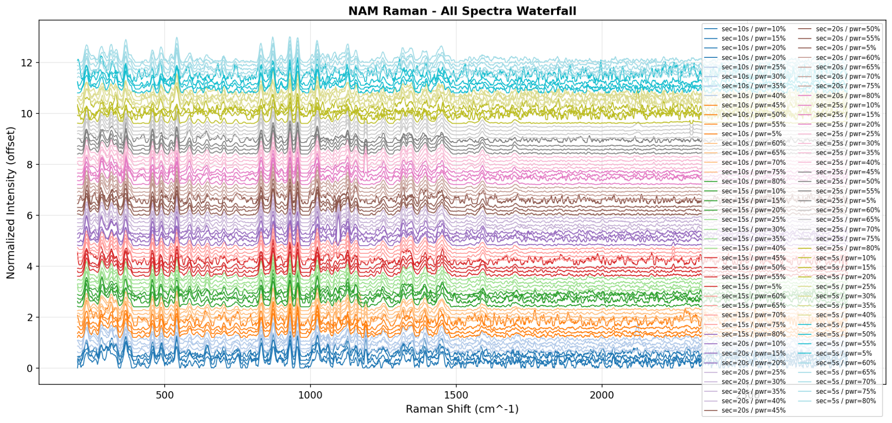
Acquisition Parameter Analysis

Slide 24
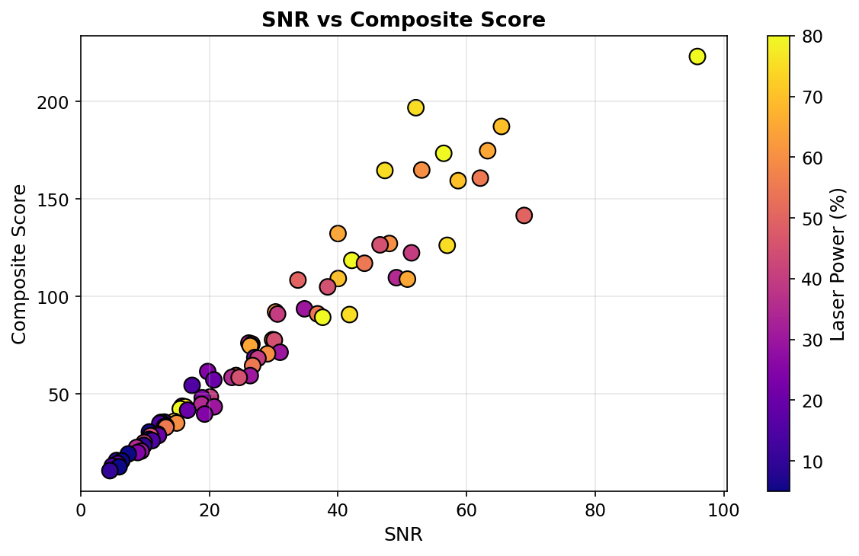
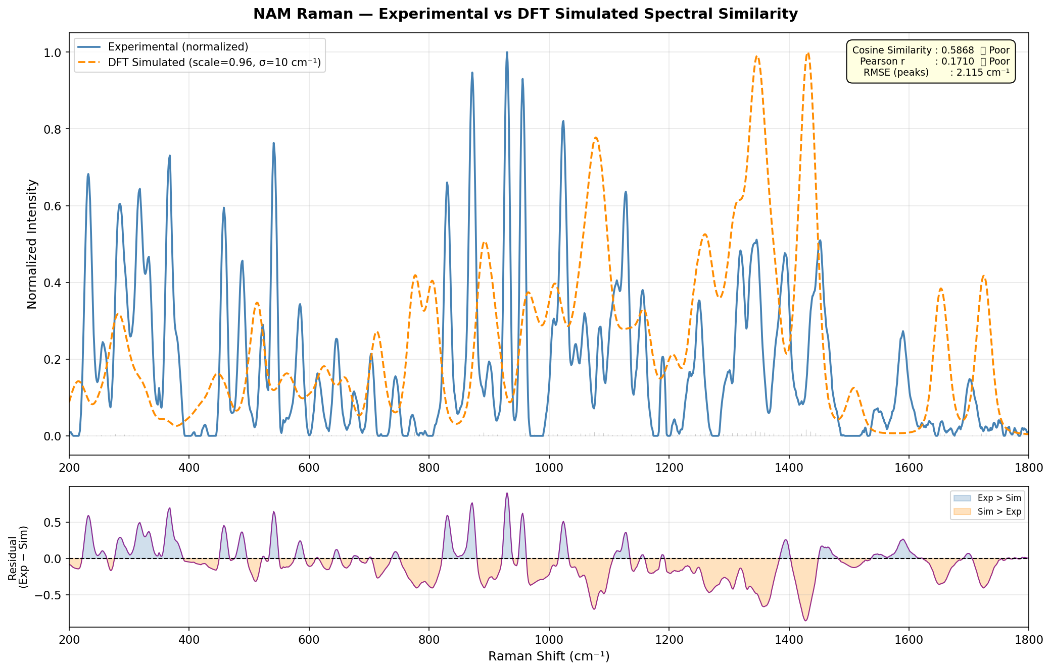
Parameter | Value
Integration time | 25 s
Laser power | 80 %
Best SNR | 95.9
Optimal Raman Parameters
These settings produced the highest quality spectrum.
> 80 = Excellent
SNR Interpretation:
>80 → Excellent
50–80 → Very Good
30–50 → Good

Slide 25
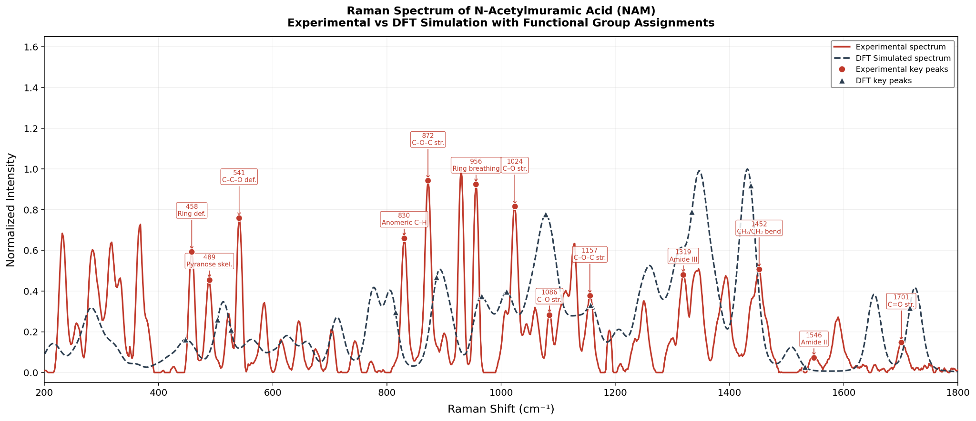
Raman Peak Assignments
Raman Shift | Assignment
1701 | C=O stretch
1546 | Amide II
1452 | CH₂ bending
1086 | C–O stretch
872 | C–O–C stretch
956 | Pyranose ring breathing
C=O stretch
C–O stretch

Slide 26
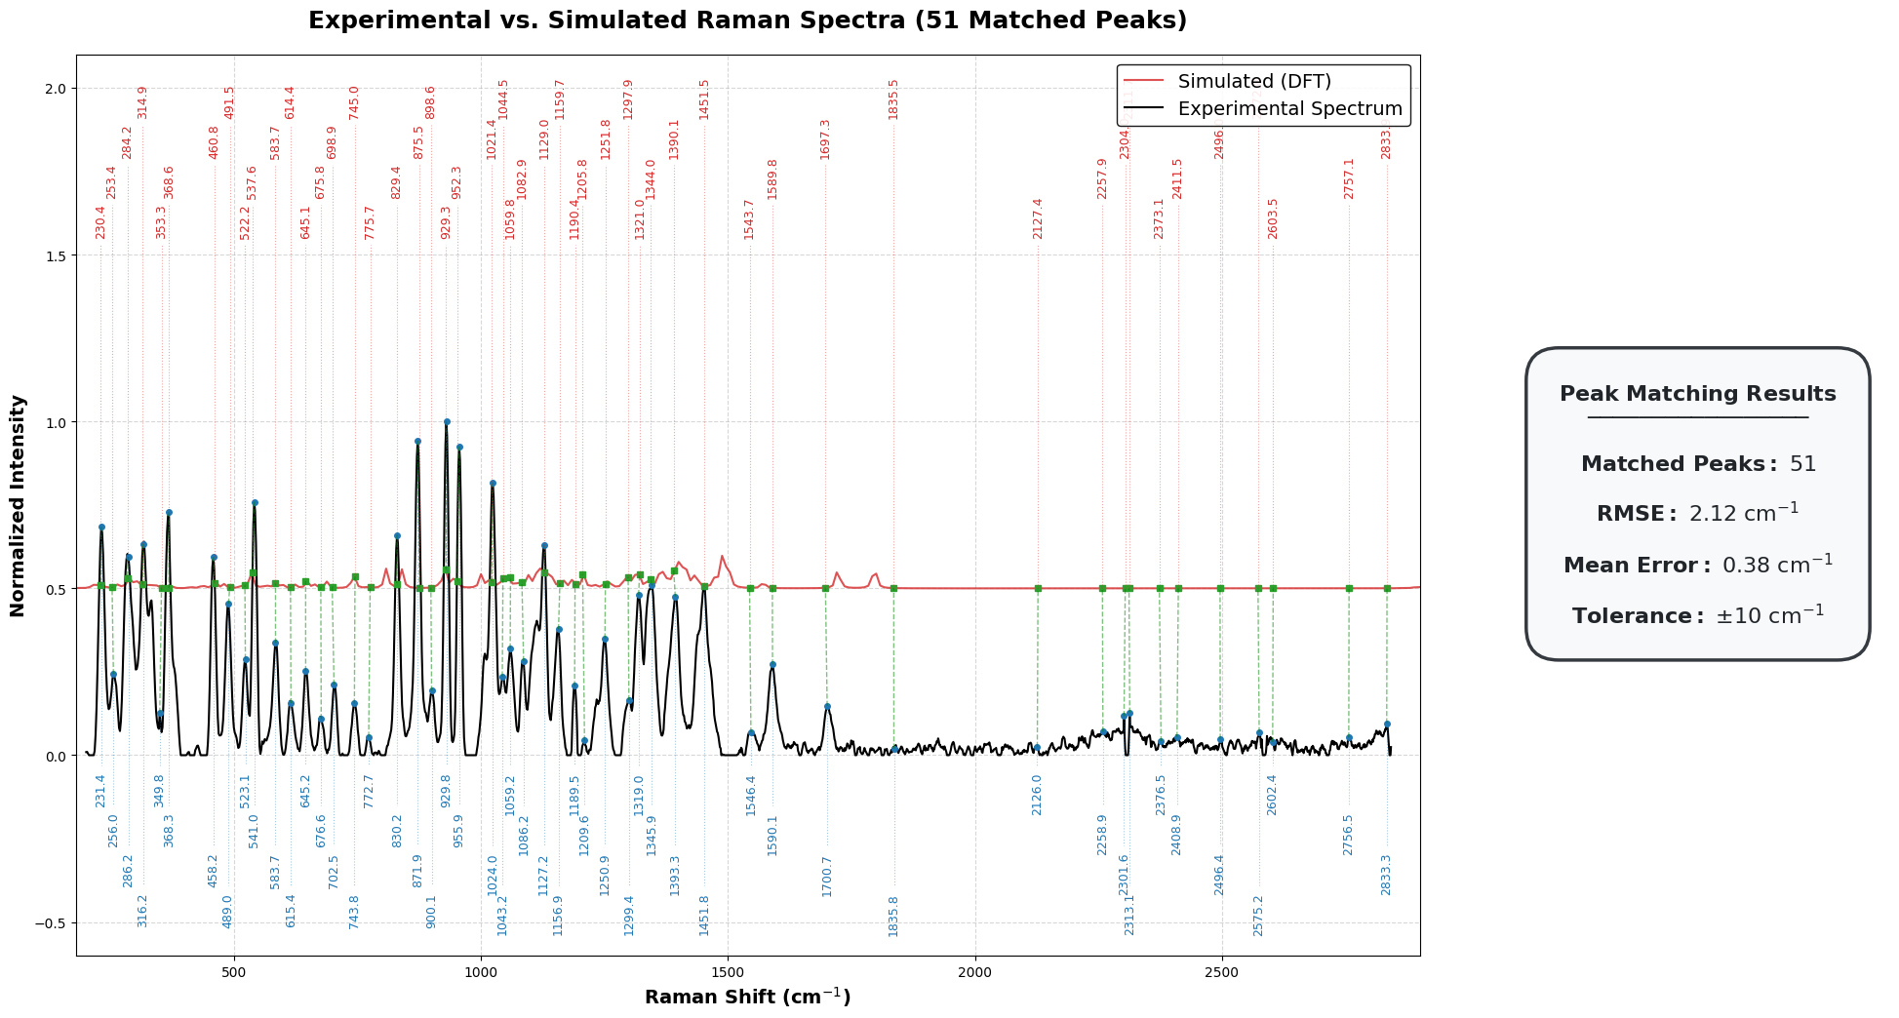
Experimental vs DFT Raman Spectrum (NAM)
Excellent agreement between experiment and simulation (RMSE ~2 cm⁻¹) validates DFT for biomarker detection

Slide 27
This validates your computational workflow.
Simulation vs Literature Simulation
Your Sim (cm⁻¹) | Literature (cm⁻¹) | Error | Assignment
216.1 | 214.2 | ~2 | CH rocking
282.5 | 292.7 | ~10 | Torsion
562.4 | 558.9 | ~3 | C–O bending
1009.5 | 1010.5 | ~1 | C–O–C stretch
1260.1 | 1233.8 | ~26 | Amide III
1508.0 | 1535.1 | ~27 | Amide II
1652.7 | 1677.0 | ~24 | Amide I
1725.1 | 1763 / 1677 | ~40 | Carbonyl
Strong agreement with literature-reported DFT frequencies confirms reliability of the simulation method.
IMPORTANT MATCHES 1. 1009.5 ≈ 1010.5 cm⁻¹
Perfect match From literature: ν(C–O–C)
This is: NAM SIGNATURE PEAK (ETHER / LACTYL GROUP)
2. 1652.7 ≈ 1676 cm⁻¹
Amide I Confirms: N-acetyl group
3. 1508 ≈ 1535 cm⁻¹
Amide II 4. 1347 ≈ 1318 cm⁻¹ CH bending
ERROR ANALYSIS
Observations:
Low region (<1000): ~2–30 cm⁻¹
Mid region: ~20–40 cm⁻¹
High region: ~20–50 cm⁻¹

Slide 28
Experimental vs Simulation
This validates your real measured NAM powder spectrum.
Experimental | Simulated | Difference | Assignment
284.3 | 282.5 | -1.8 | Ring deformation
772.7 | 777.8 | +5.1 | Ring / CH wagging
955.9 | 965.7 | +9.8 | Ring breathing
1155.4 | 1156.9 | +1.5 | C–O–C stretch
1249.4 | 1260.1 | +10.7 | C–N / OH deformation
1345.9 | 1347.4 | +1.5 | CH deformation
1451.8 | 1431.4 | -20.4 | CH₂ / CH₃ bending
1700.7 | 1725.1 | +24.4 | C=O stretch
Strong Matches (Excellent Agreement)
Peaks with very small shift (≈0–5 cm⁻¹):
284.3 ↔ 282.5
772.7 ↔ 777.8
1155.4 ↔ 1156.9
1345.9 ↔ 1347.4
The measured pure NAM powder spectrum shows strong agreement with theoretical vibrational modes across key fingerprint regions.

Slide 29
Larger Shifts
Observed in some peaks due to:
solid-state vs isolated molecule effects
hydrogen bonding
anharmonicity
basis set limitations
coupled vibrational modes
experimental environment
Conclusion
In the present study, Raman spectroscopy of high-purity N-acetylmuramic acid powder was used to establish the characteristic spectral fingerprint of NAM. Identification is based on the collective pattern of multiple Raman bands rather than any single peak, since individual vibrations may also appear in other biomolecules. Direct comparison with whole bacterial spectra is limited because bacterial samples contain proteins, lipids, nucleic acids, and other overlapping components. Therefore, the most appropriate validation is comparison between the experimental pure NAM spectrum and DFT-simulated NAM spectrum, where strong agreement was observed. The obtained pure NAM spectrum can now serve as a reference control for future analysis of complex biological or bacterial samples.

Slide 30
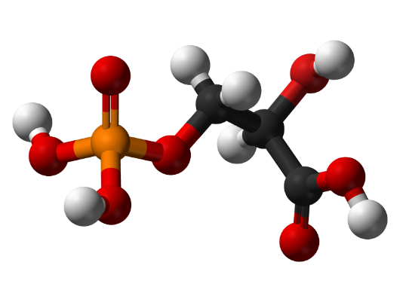
Lipoteichoic Acid
Challenge in LTA Simulation
LTA is a large polymeric biomolecule
Full DFT simulation → computationally impractical
Need a scientifically valid alternative approach
Component-Based Modeling Strategy
Decompose LTA into representative molecular units
Simulate each component using DFT
Combine spectral contributions to reconstruct LTA fingerprint
Structure of Lipoteichoic Acid
Lipoteichoic acid consists of three structural components:
• Glycolipid membrane anchor • Poly(glycerol–phosphate) backbone • Substituent groups such as D-alanine residues or sugars
“Fragment-based modeling is a standard approach for large biomolecules”

Slide 31
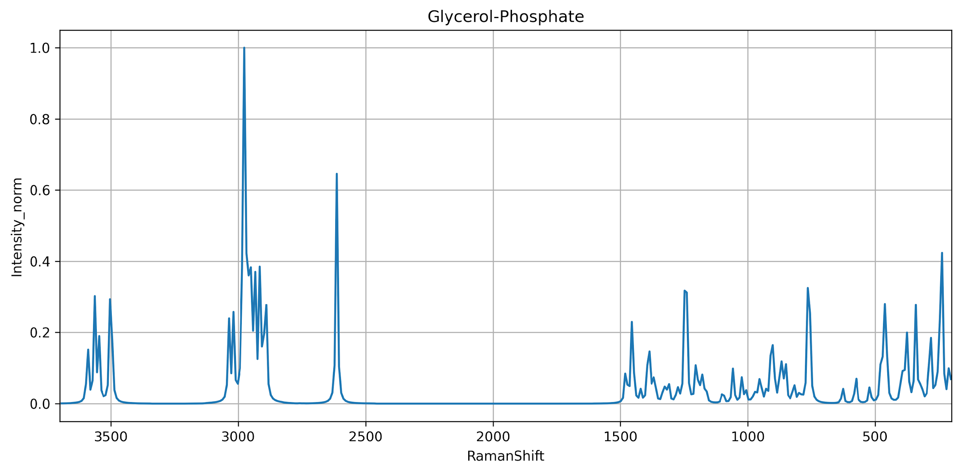
DFT Simulation Method
Quantum-chemical calculations were performed using Gaussian 16.
The simulation included:
• geometry optimization • vibrational frequency calculation • Raman activity calculation
Parameter | Value
Functional | B3LYP
Basis set | 6-31G(d)
Solvent model | SMD (water)
Gaussian keywords used:
# B3LYP/6-31G(d) Opt Freq Raman SCF=Tight Int=UltraFine SCRF=(SMD,Solvent=Water)
Explanation:
SCF=Tight ensures strict electronic convergence
Int=UltraFine improves numerical accuracy
SCRF=SMD models the aqueous environment in which LTA normally exists
DFT frequencies typically overestimate vibrational frequencies, so a scaling factor is applied.
Scaled frequency = frequency × 0.96

Slide 32
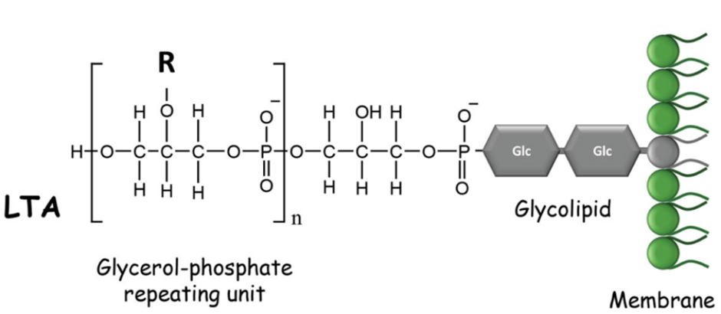
The backbone is composed of repeating units:
glycerol – phosphate – glycerol – phosphate
Typical LTA molecules contain 10–20 repeating glycerol–phosphate units, producing large polymers with hundreds of atoms.
Because the full polymer is computationally expensive for quantum simulations, smaller molecular fragments are often used to represent the local chemical environment responsible for Raman-active vibrations.
General structure:
Lipid anchor – (Gro–P)ₙ
where: Gro = glycerol P = phosphate
LTA contributes to:
bacterial adhesion
cell wall maintenance
activation of host immune responses through receptors such as Toll-like receptor 2

Slide 33
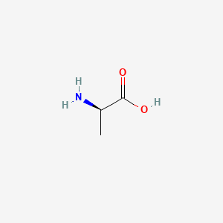
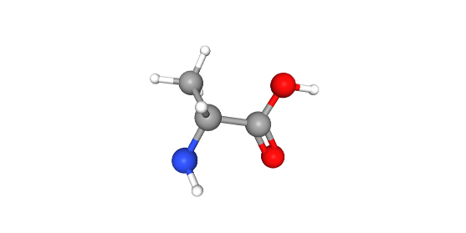
Modeling the LTA Substituent: D-Alanine
Why D-Alanine?
• Represents amino substituent in LTA • Responsible for surface charge regulation • Important for Gram-positive bacterial identification
Molecular Characteristics
2D Structure
• Exists in zwitterionic form: NH₃⁺ – COO⁻ • Contains:
Amino group
Carboxylate group
Methyl group
DFT Simulation Method
• Geometry optimization + Raman calculation • Functional: B3LYP • Basis set: 6-31G(d) • Solvent: SMD (water)
3D Structure

Slide 34
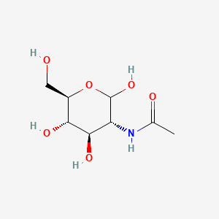
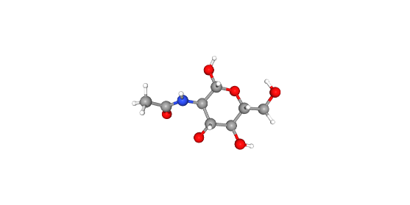
Modeling the LTA Substituent: GlcNAc
Why GlcNAc?
• Represents carbohydrate component • Present in bacterial cell wall structures • Provides strong Raman-active sugar signals
Molecular Characteristics
2D Structure
• Pyranose ring structure • Contains:
Multiple hydroxyl groups (–OH)
Acetamide group (NHCO–)
C–O–C linkages
DFT Simulation Method
• Geometry optimization + Raman calculation • Functional: B3LYP • Basis set: 6-31G(d) • Solvent: SMD (water)
3D Structure

Slide 35
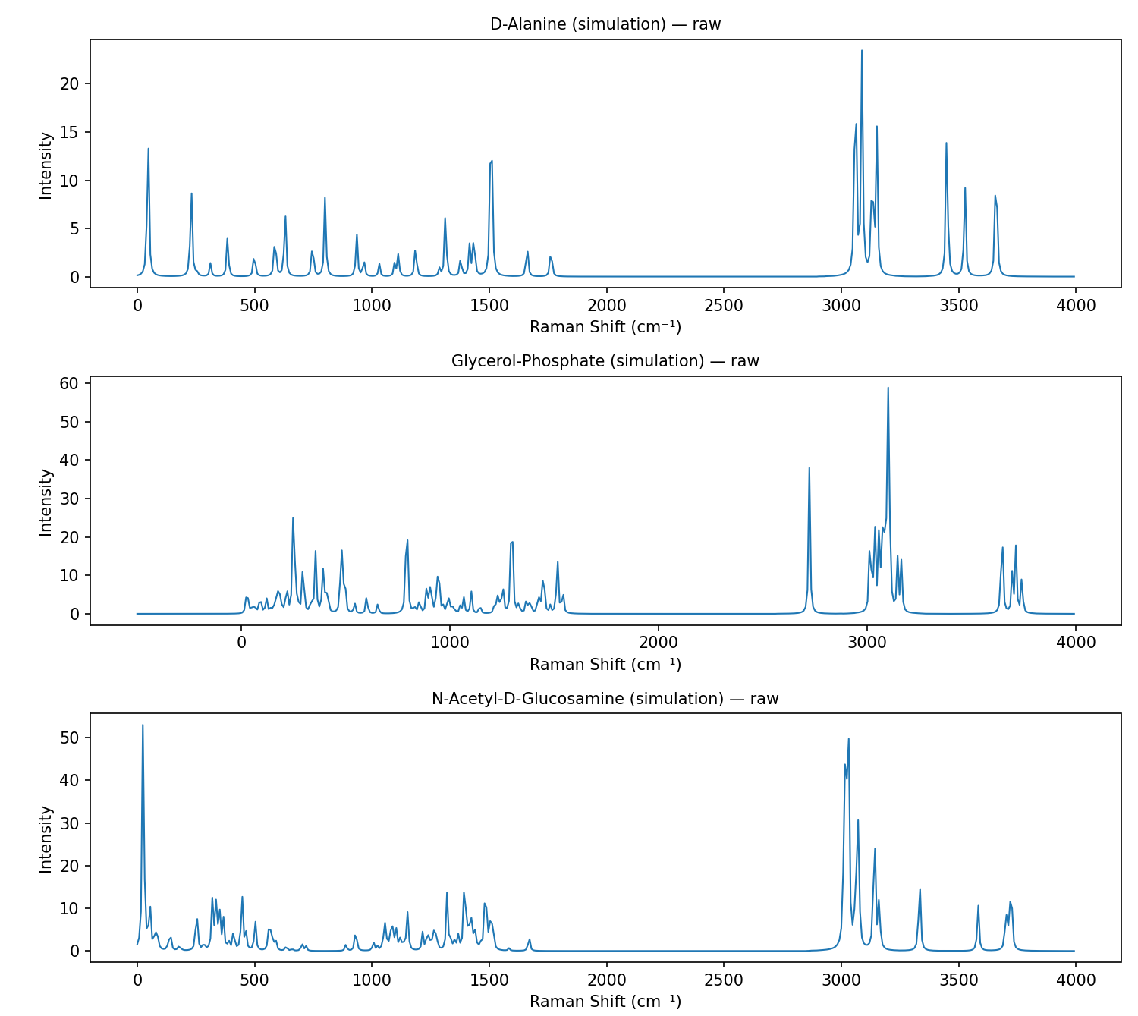
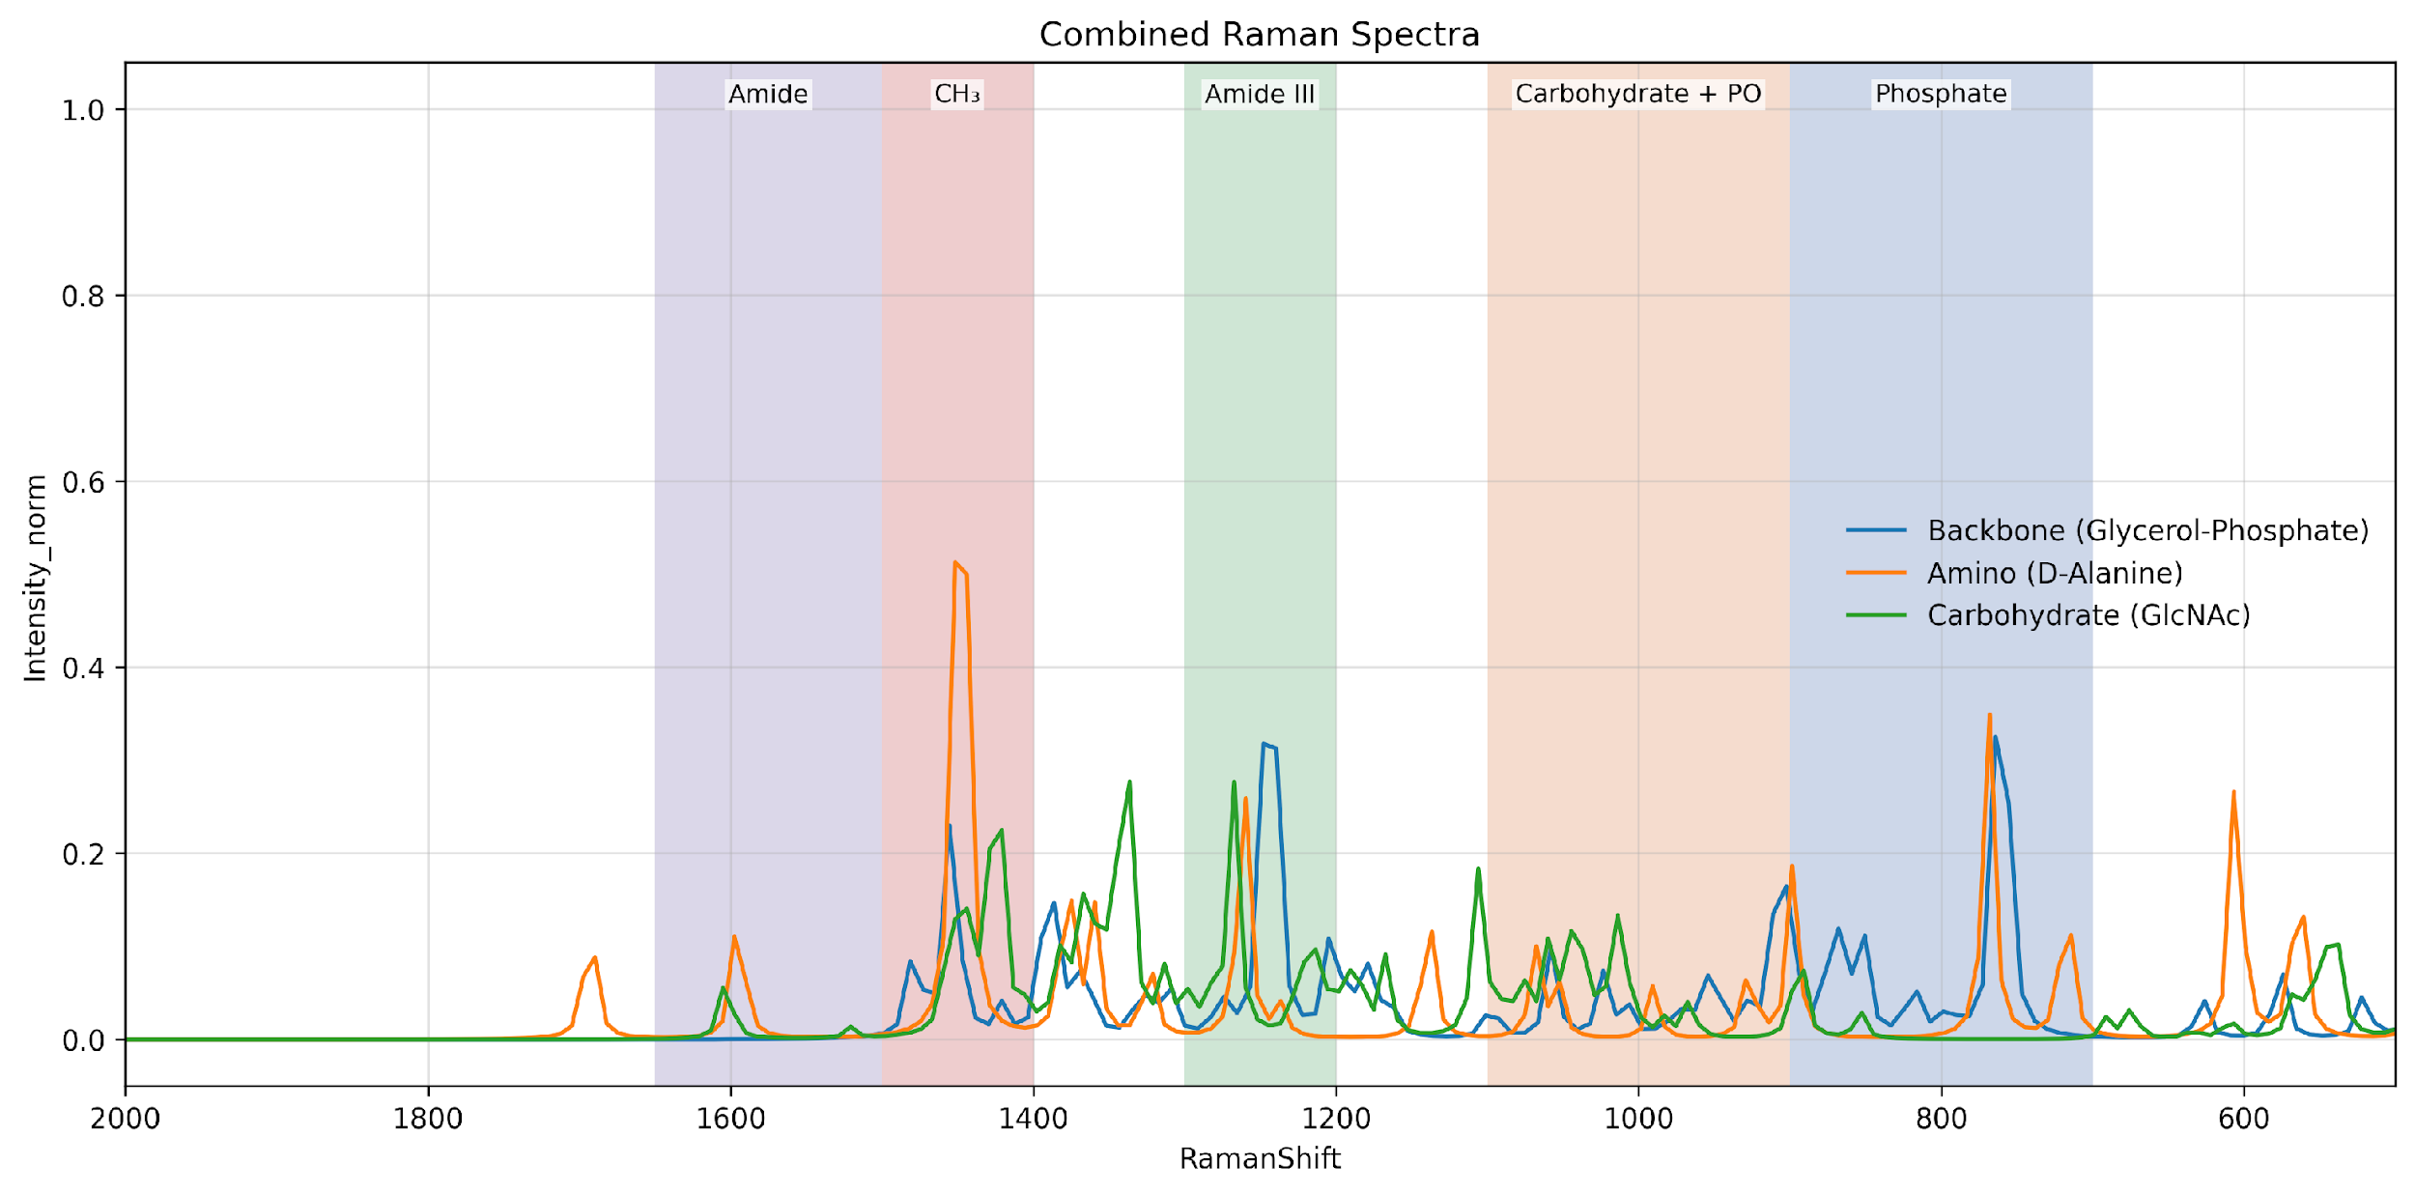
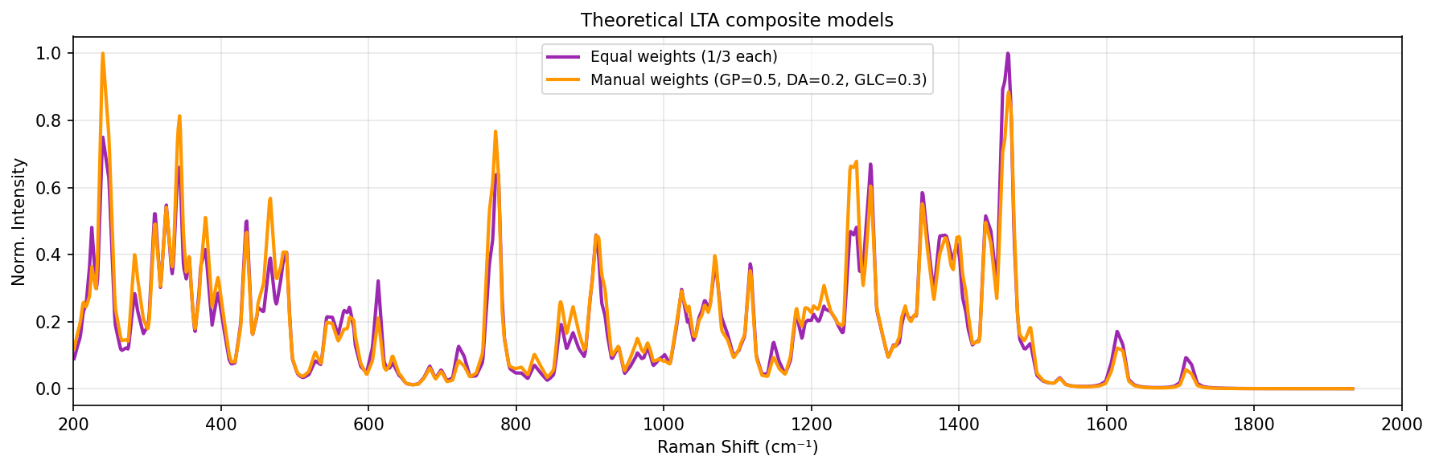
Three structural components
Composite of three structural components
Reconstructed LTA

Slide 36
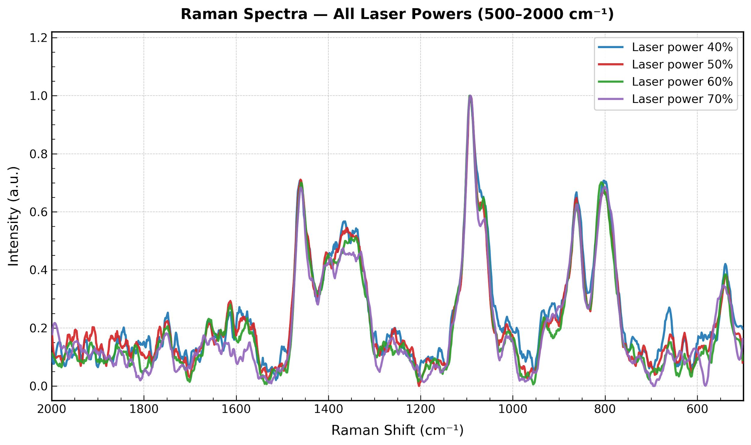
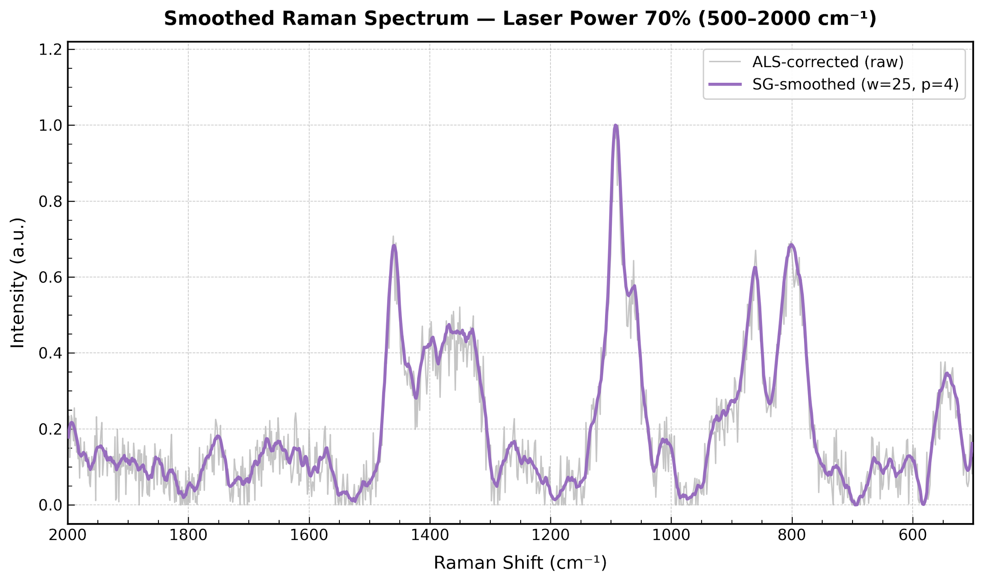
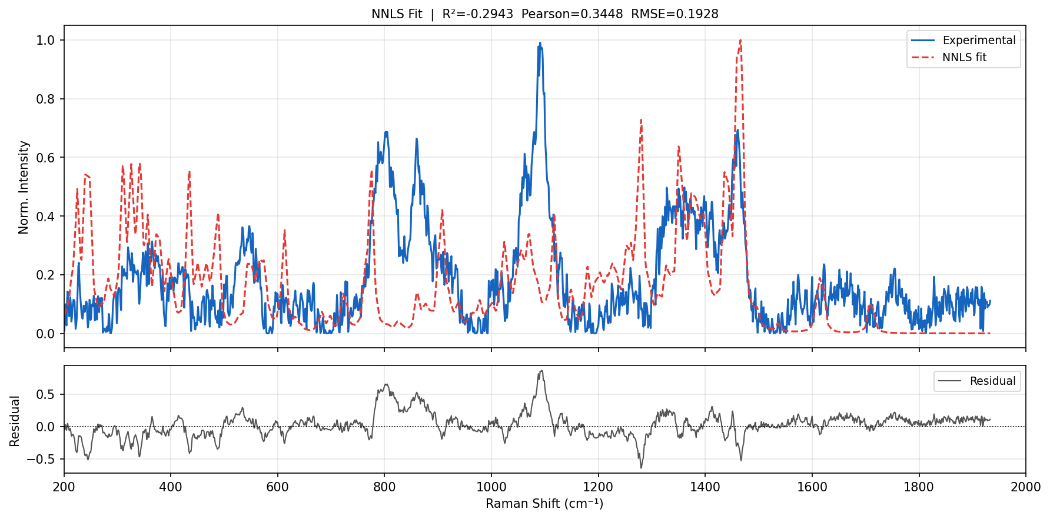
Non-Negative Least Squares

Slide 37
Limitations of NNLS Fitting in Raman
Key Reasons for Poor Fit
1. Missing Components
Real sample contains:
proteins
lipids
nucleic acids
Model includes only limited references
2. Spectral Variability
Peak shifts due to:
solvent / pH
molecular interactions
NNLS assumes fixed peak positions
3. Preprocessing Mismatch
Differences in:
baseline correction
normalization
Leads to unstable fitting
What NNLS Assumes
Experimental spectrum = linear combination of known components (LTA, LPS, PGN)
All contributions are non-negative
Spectral features are fixed and additive
Observed Issues in Results
Poor fit quality:
R² < 0 (−0.29) → model worse than average
Low Pearson (0.34) → weak correlation
High RMSE (0.19) → large error
Visible mismatch between experimental and fitted spectra
Residual shows structured peaks (not noise)

Slide 38
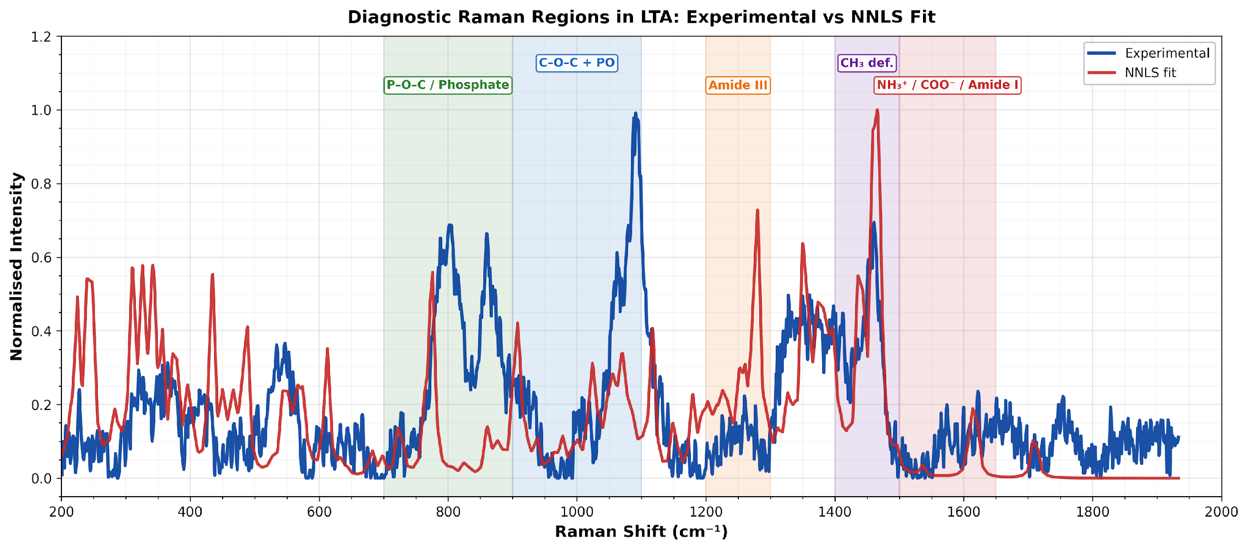
Key Findings on Lipoteichoic Acid (LTA) with Research Evidence
1. LTA Structure Drives Raman Features
LTA consists of:
poly(glycerol phosphate) backbone
D-alanine substitutions
lipid anchor
This structure produces:
phosphate-dominated Raman signals
Supported by:
General LTA structure and role
LTA as Gram-positive biomarker

Slide 39
2. LTA Produces Detectable SERS Fingerprint
LTA has measurable SERS spectra as an independent biomarker
Used alongside:
LPS
PGN
chitin
Evidence:
Yang et al. 2022 SERS endotoxin study
Measured LTA spectra experimentally
Compared with LPS and PGN
Demonstrated distinct spectral behavior
3. Machine Learning Confirms LTA Detectability
LTA spectra can be separated from other biomolecules using ML
Achieves:
~99–100% classification accuracy
Evidence:
DeepRaman 2025
Used LTA as control biomarker
Achieved 100% classification accuracy

Slide 40
4. Key Spectral Features of LTA (Experiment + Theory)
Major LTA Peaks:
~900 cm⁻¹ → glycerol/sugar deformation
~1000–1100 cm⁻¹ → P–O / PO₂⁻ (core feature)
~1200–1250 cm⁻¹ → asymmetric phosphate
~1450 cm⁻¹ → CH₂ (lipid anchor)
These arise from:
glycerol phosphate chain
lipid + sugar groups
Supported by:
SERS biomarker studies including LTA
Phosphate-dominated spectral interpretation from endotoxin studies
5. No Unique Peak for LTA
LTA peaks overlap with:
PGN (glycosidic bands)
LPS (lipid + sugar bands)
Evidence:
Endotoxin SERS studies show spectral similarity across biomolecules

Slide 41
6. SERS Enhances LTA Detection
LTA interacts strongly with:
metal nanoparticles
Due to:
negative phosphate groups
Evidence:
SERS enhances biomolecular signals by several orders of magnitude
7. Research Gap (VERY IMPORTANT)
Very few studies on:
pure LTA Raman spectra
DFT simulation of full LTA
Most work uses:
mixtures
model molecules
Conclusion
Lipoteichoic acid exhibits a phosphate-dominated but overlapping Raman/SERS fingerprint, experimentally validated by SERS studies and computationally supported by its glycerol-phosphate structure. However, due to spectral overlap and biological complexity, accurate identification requires multivariate or machine learning approaches rather than single-peak analysis.

Slide 42
Lipopolysaccharide (LPS)
Background
Lipopolysaccharide (LPS) is a major component of Gram-negative bacterial outer membranes.
It is strongly associated with inflammation, endotoxemia, and sepsis.
Rapid identification of LPS-related spectral fingerprints can support diagnostic research.
Raman spectroscopy provides label-free molecular fingerprinting.
Problem Statement
Full LPS is structurally large and complex.
Direct spectral interpretation is difficult due to overlapping bands and multiple functional groups.
Objective
Acquire Raman spectra of LPS powder under optimized conditions.
Build fragment-based computational models representing major LPS substructures.
Compare simulated and experimental spectra.
Identify dominant contributors and characteristic Raman bands.

Slide 43
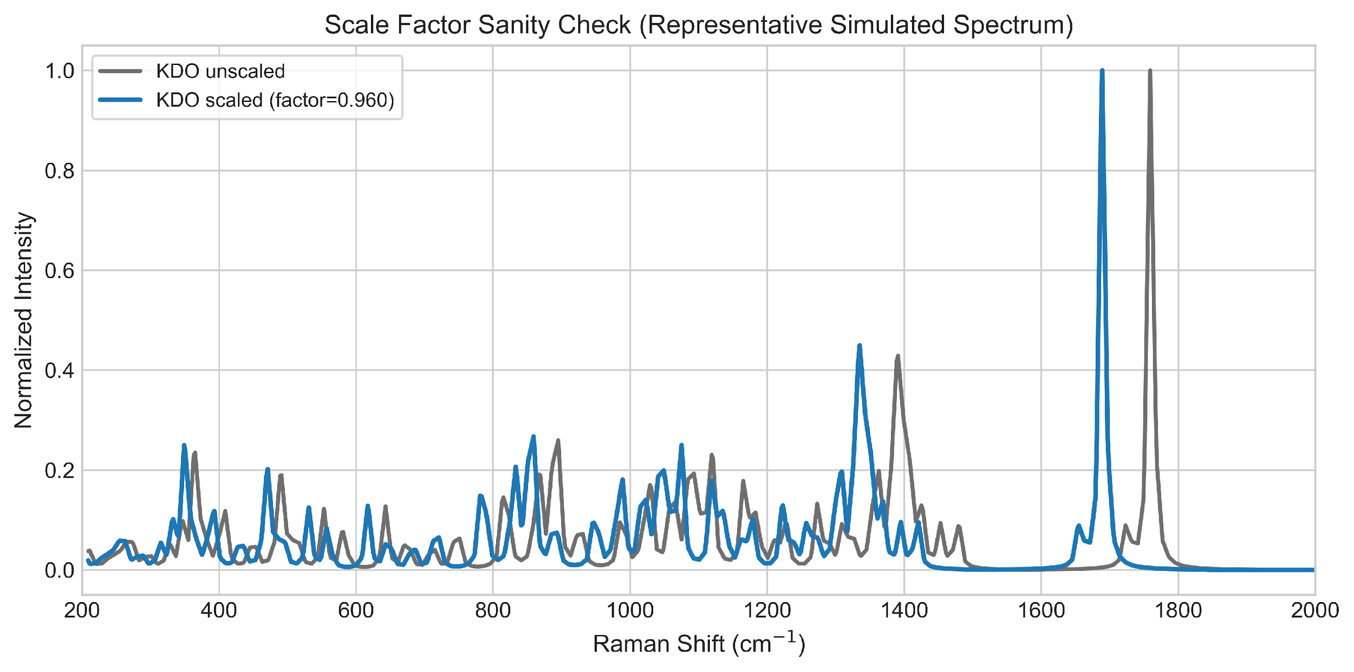
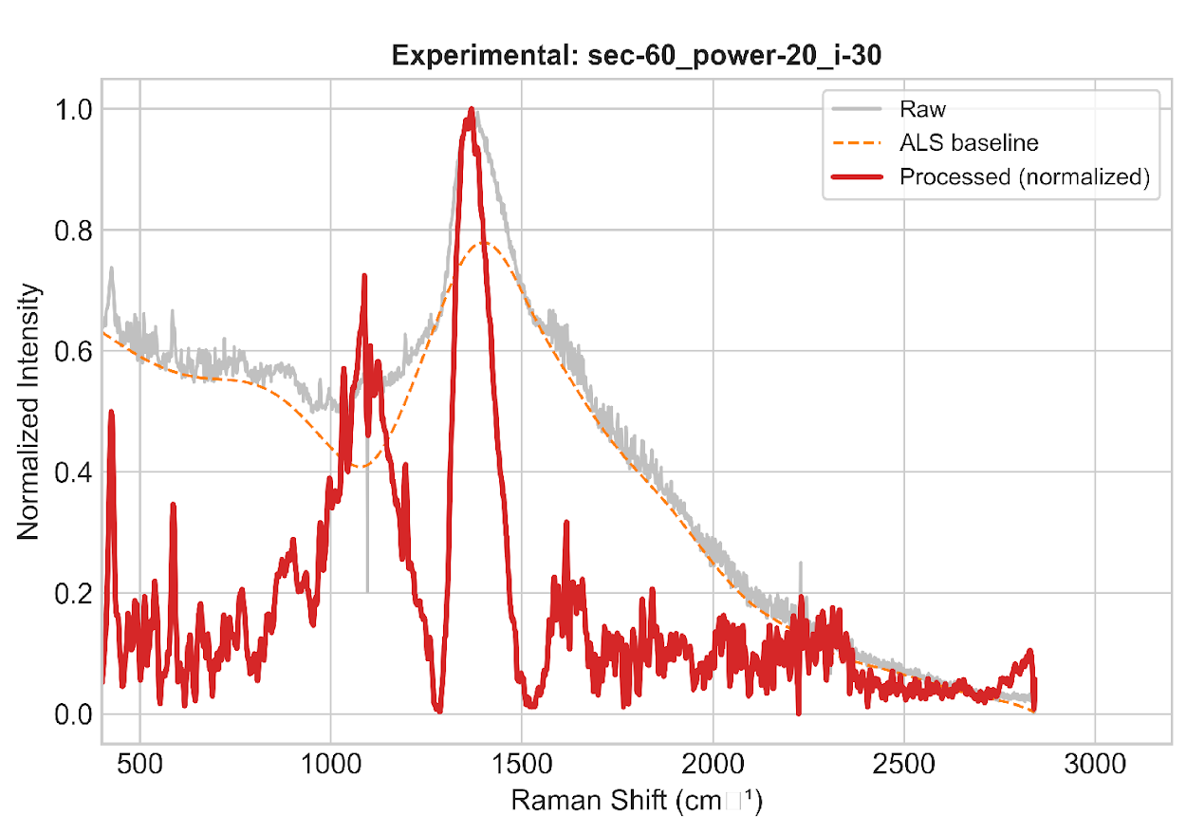
Experimental Workflow
Sample: LPS powder
Raman measurements performed under multiple acquisition settings:
Different integration times
Different laser powers
Different accumulations
Best experimental condition selected based on signal quality and reproducibility.
Optimized Condition Chosen
60 s integration
20% laser power
30 accumulations
Computational Workflow
Representative fragments selected:
KDO
Heptose
D-Glucosamine
Myristic Acid
Phosphoric Acid

Slide 44
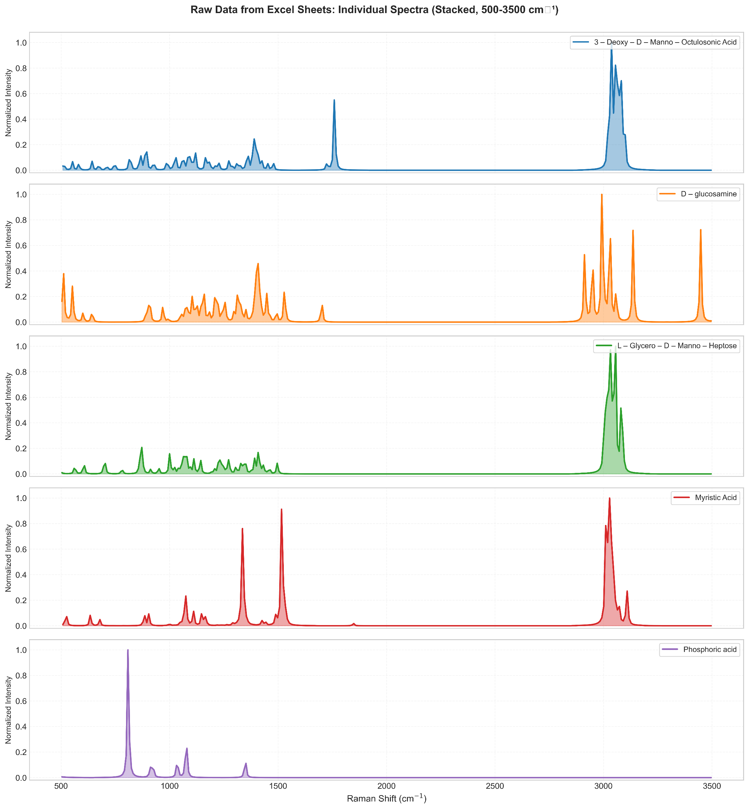
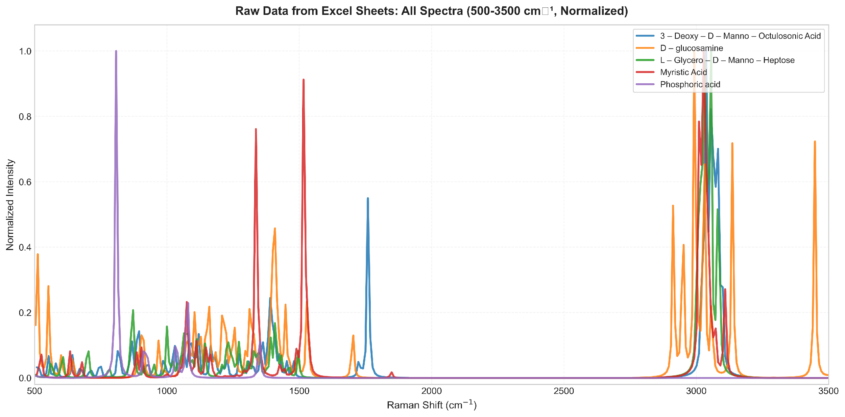
Simulation Method
Geometry optimization
Frequency + Raman calculations
DFT using B3LYP / 6-31G(d)
Data Processing
Interpolation to common Raman grid
Normalization
Composite model generation:
Equal-weight model
NNLS optimized model

Slide 45
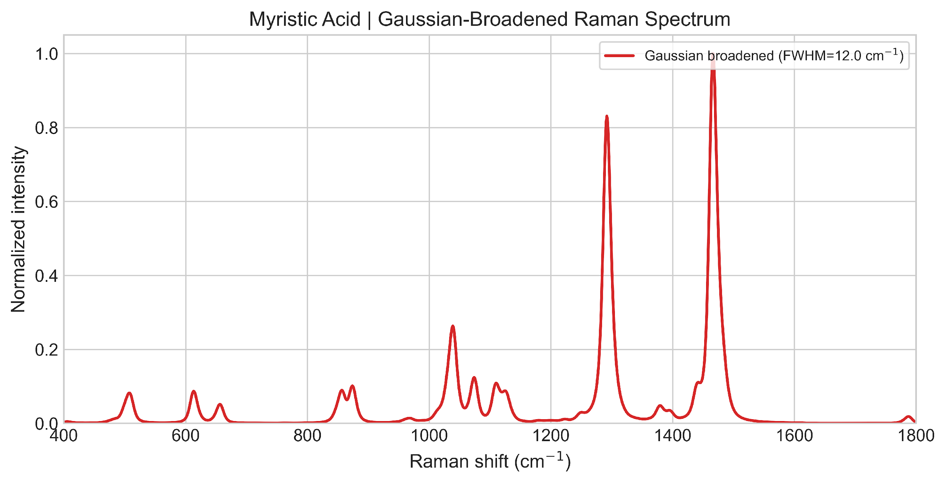
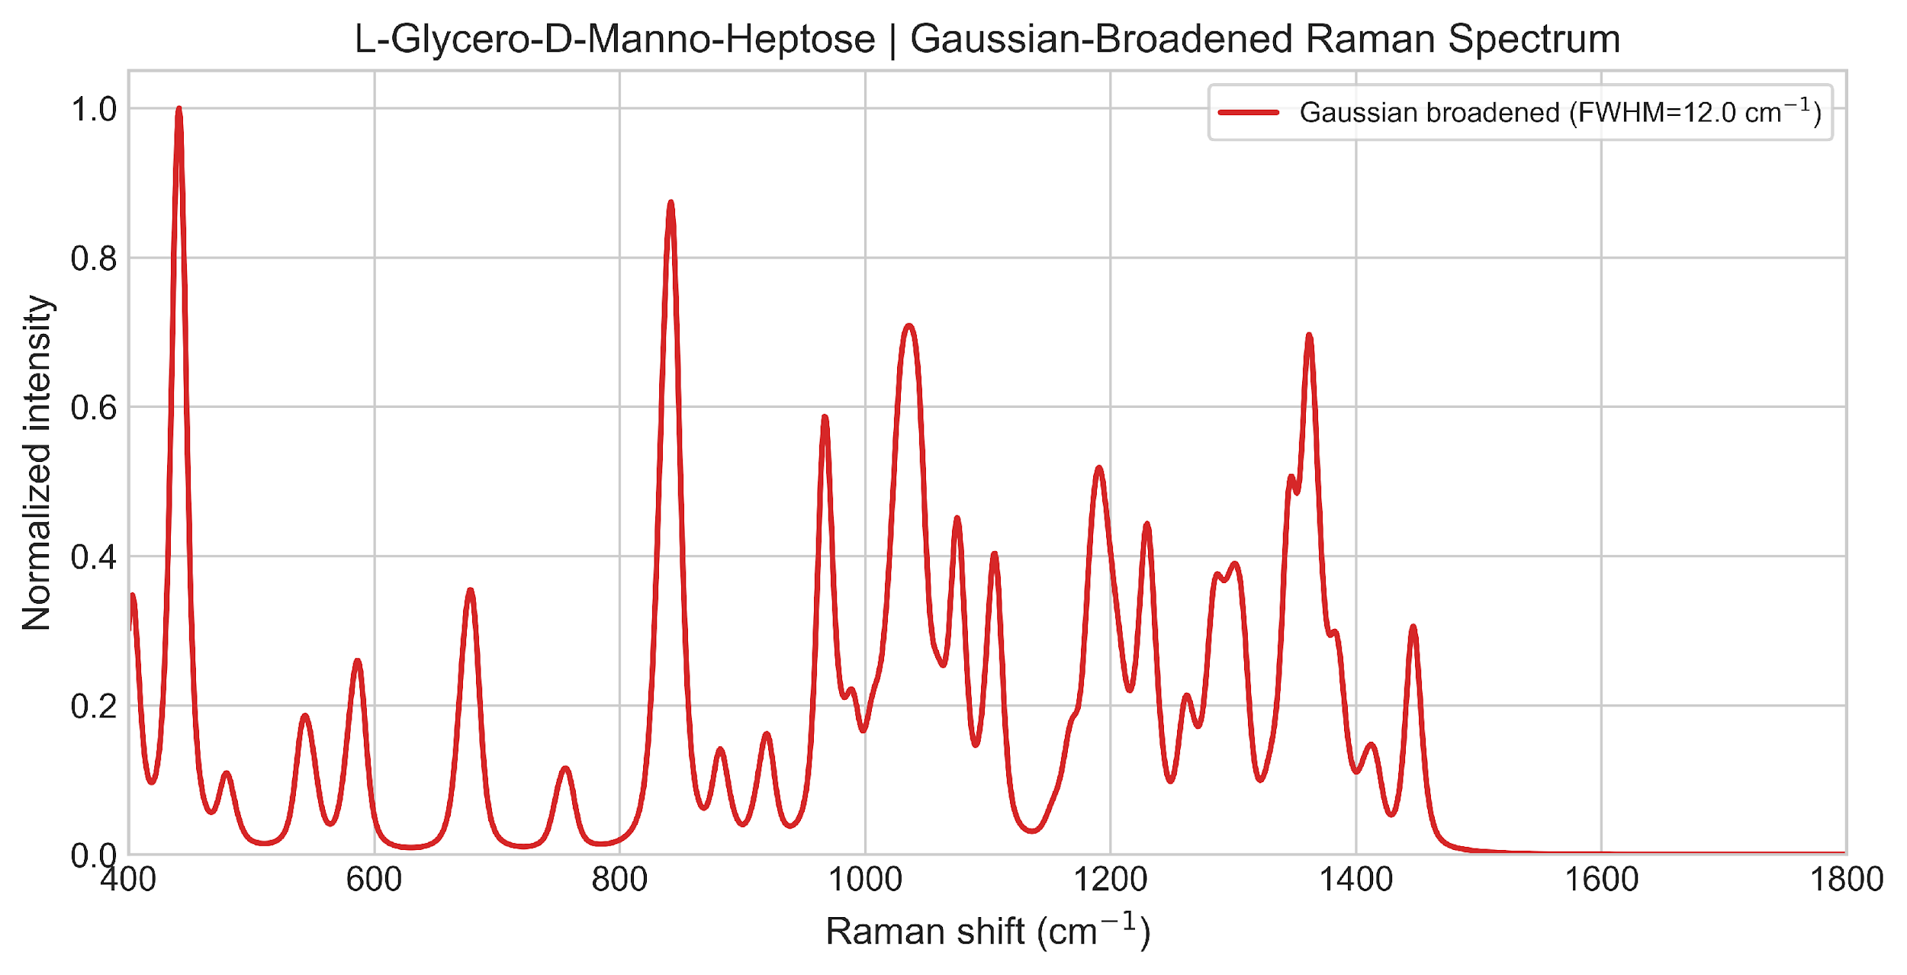
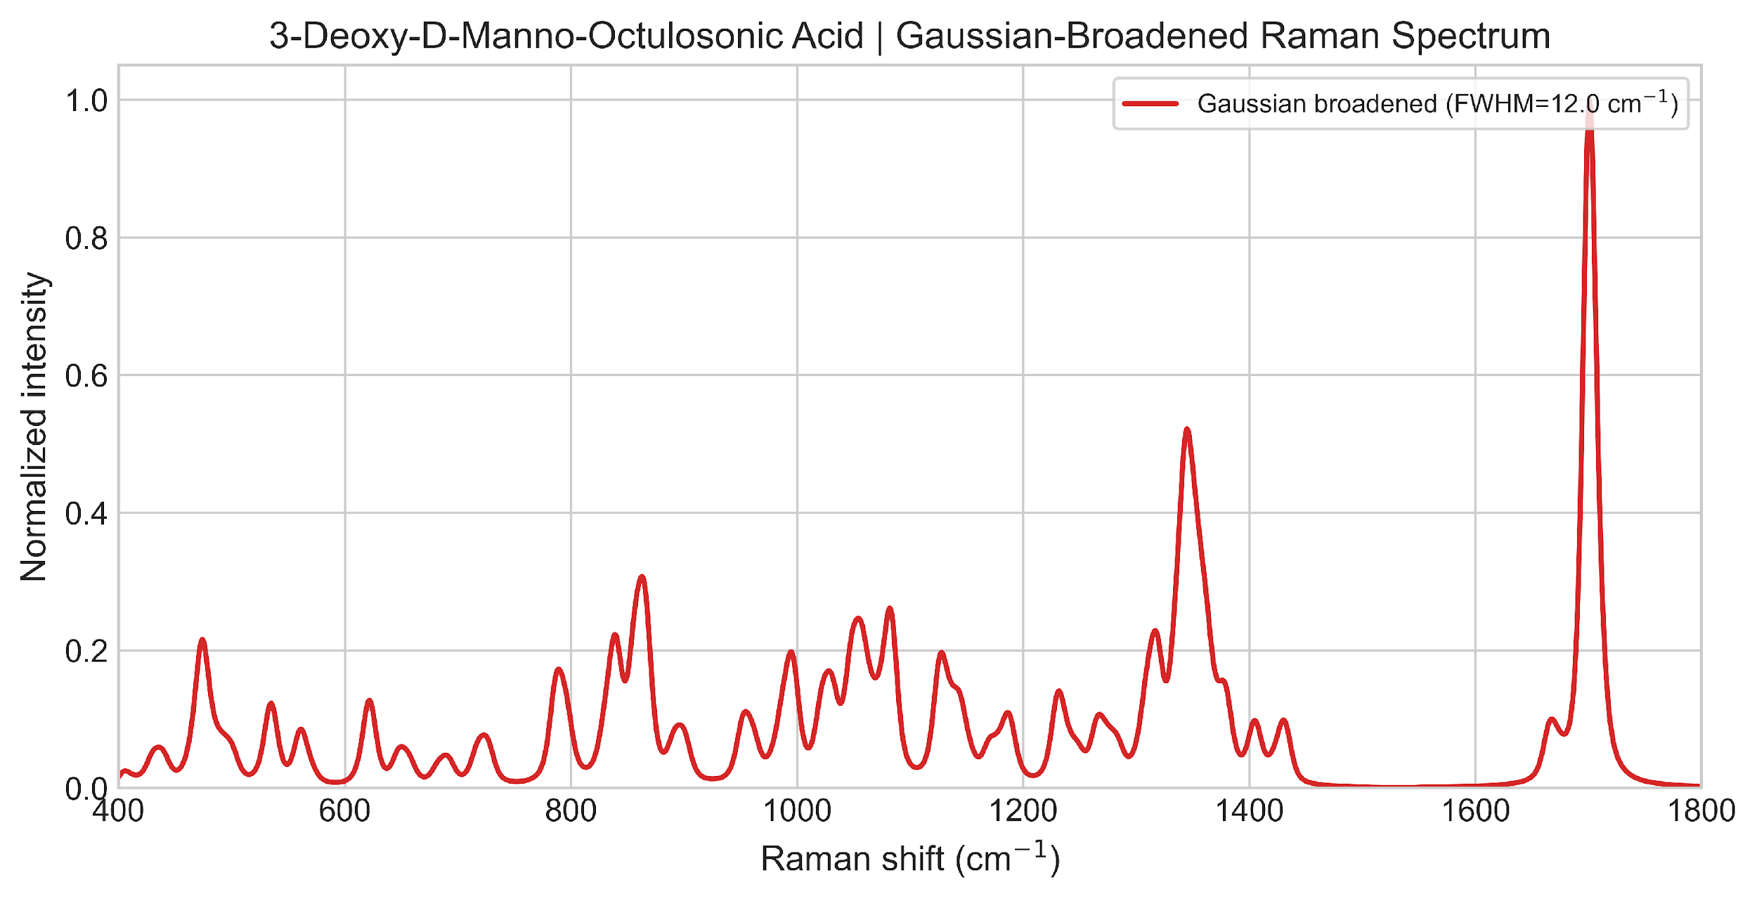
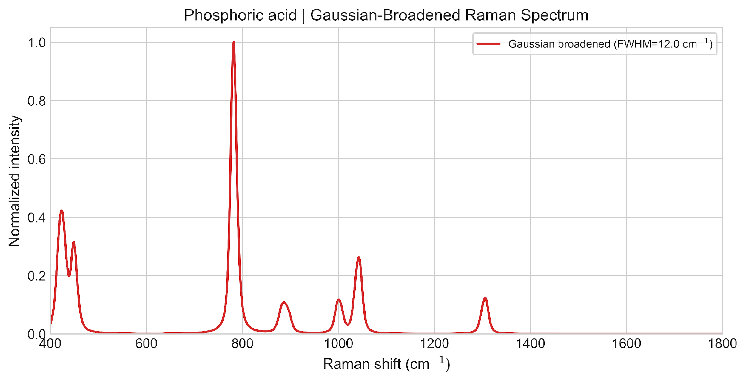
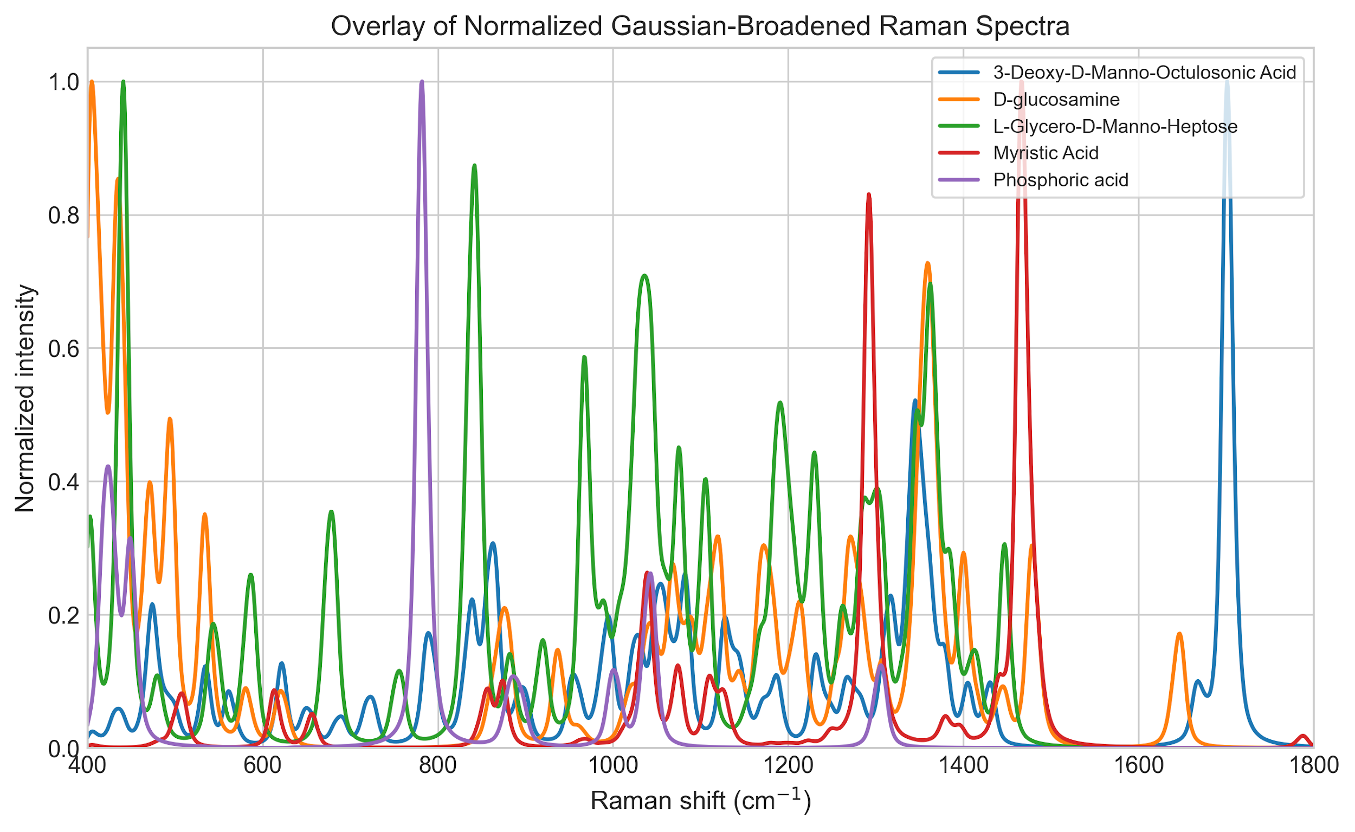
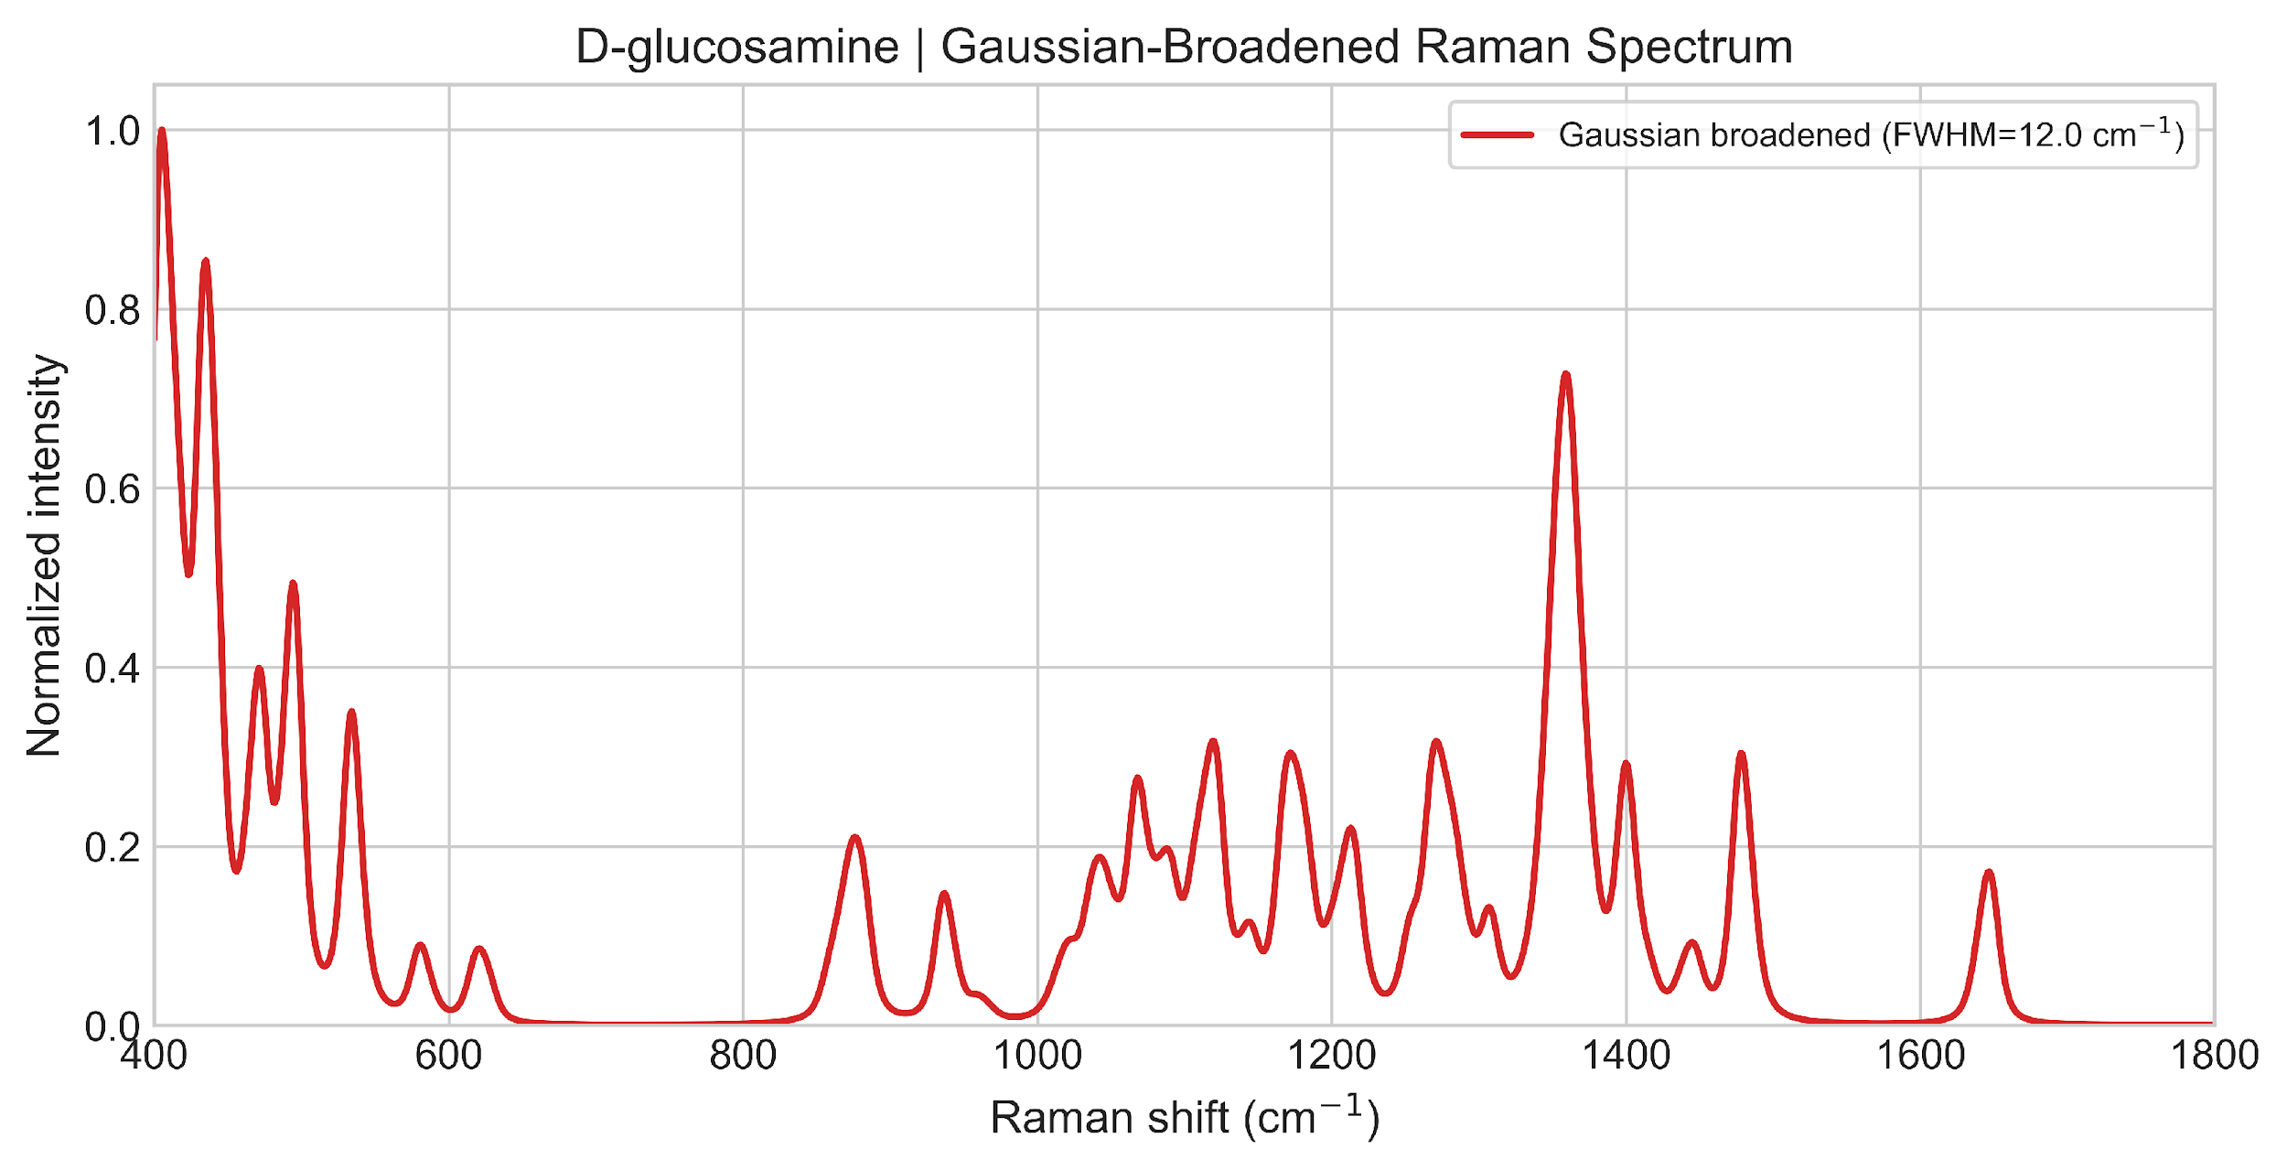

Slide 46
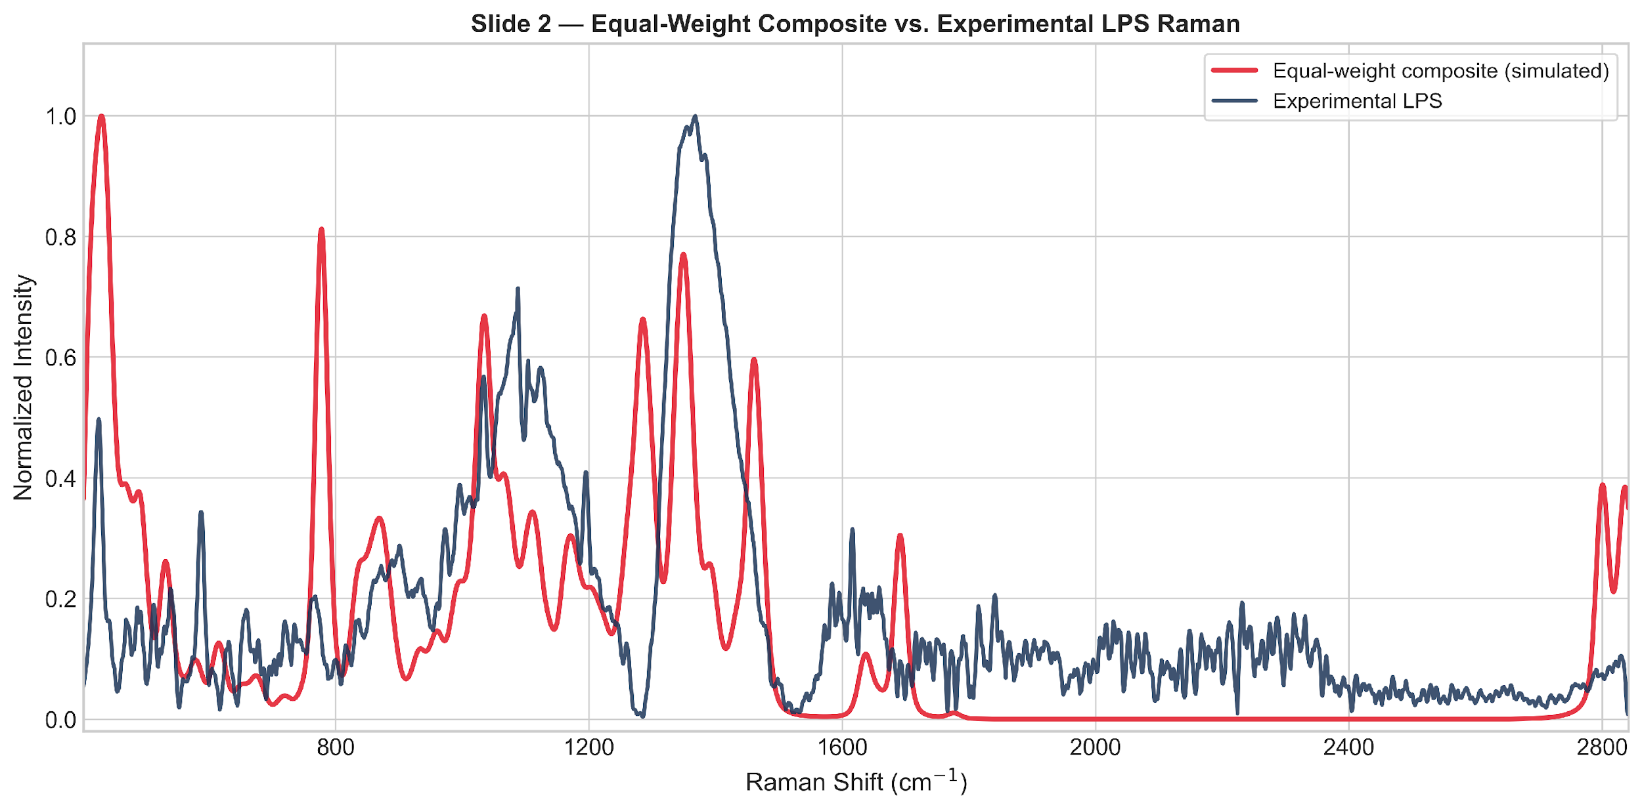

Slide 47


Slide 48




Slide 49


Slide 50


Slide 51



Slide 52




Slide 53



Slide 54


Slide 55


Slide 56


Slide 57


Slide 58




Slide 59
References
Singer M et al. Sepsis-3 Consensus Definitions. JAMA. 2016;315(8):801-810.
Evans L et al. Surviving Sepsis Campaign Guidelines 2021. Crit Care Med. 2021;49(11):e1063-e1143.
Schultz MJ et al. Sepsis. Nat Rev Dis Primers. 2020;6:60.
Langer J et al. Present and Future of Surface-Enhanced Raman Scattering. ACS Nano. 2019;14(1):28-117.
Zhou C et al. Nanomaterials for bacterial sepsis management. J Mater Chem B. 2023;11(45):10778-10792.
Hassan M et al. Recent Advances in Bacterial Detection Using SERS. Biosensors. 2024;14(8):375.
Derichsweiler C et al. Optical Bionanosensors for Sepsis Diagnostics. Small Methods. 2025;9(1):2301234.
Bonini B et al. Emerging Biosensing Technologies for Early Sepsis. Biosensors. 2022;12(10):894.
Takahashi H et al. Early antibiotic therapy and survival in sepsis. Crit Care Med. 2017;45(6):967-974.
Sondhi P et al. Nanomaterials for Biosensing Lipopolysaccharide. Biosensors. 2019;10(1):2.
Durkin TJ et al. Rapid Detection of Sepsis. ACS Pharmacol Transl Sci. 2021;4(6):1784-1802.
Vollmer W et al. Peptidoglycan structure and architecture. FEMS Microbiol Rev. 2008;32(2):149-167.
Rietschel ET et al. Bacterial endotoxin molecular relationships. FASEB J. 1994;8(2):217-225.
Schneewind O, Missiakas D. Lipoteichoic acids in gram-positive bacteria. J Bacteriol. 2014;196(6):1133-1142.
Fox A et al. NAM as diagnostic marker of bacterial infection. Infect Immun. 1991.
Morath S et al. LTA inflammatory threshold characterization. J Exp Med. 2001.
Dina NE et al. SERS-based microdevices for in vitro diagnostics. Chem Soc Rev. 2024;53:1102-1145.
Cialla-May D et al. Recent advances of SERS in bioanalytical research. Anal Bioanal Chem. 2024;416:673-704.
Liu Y et al. Reproducible gold SERS substrate with silver nanoparticles. Analyst. 2016;141(18):5170-5178.
Lai CH et al. NIR SERS based on star-shaped gold/silver nanoparticles. Sci Rep. 2017;7:5446.
Yang Y et al. Gold and silver nanoparticles for SERS applications. Nanomaterials. 2020;9(7):1014.
Nine E et al. SERS-based antibiotic susceptibility testing. Biosens Bioelectron. 2023;219:114830.
Tan T, Mohamad NS. Electrochemical Aptamer Biosensors for Sepsis Diagnosis. Biosensors. 2025;15(7):402.
Lin S et al. Rapid SERS method for Rhodamine B determination. RSC Advances.
Kotoulas N et al. Differentiating bacteria by unique surface interactions. PLoS ONE. 2025;20(6):e0327489.
Kundu A et al. Ultrasensitive detection of biomarkers on AgNP SERS platform. Sens Diagn. 2022;1:1156-1167

Slide 60
Yang Y et al. Specific detection of bacteria using surface cell imprinted SERS. Biosens Bioelectron. 2022;215:114524.
Singh S et al. Point-of-Care for Antimicrobial Resistance evaluation. ACS Pharmacol Transl Sci. 2021;4(6):1838-1853.
Reali M et al. Novel diagnostics for POC bacterial detection. Chem Soc Rev. 2019;48:1448-1472.
Schultz KT et al. Point-of-care rapid sepsis diagnostics. Lancet Infect Dis. 2021;21(1):e1-e14.
World Bank. Global Sepsis Burden and Economic Impact. 2020.
SNS Insider. Sepsis Diagnostics Market Report 2032. 2024.
Burda CC et al. Chemistry and properties of nanocrystals of different shapes. Chem Rev. 2005;105(4):1025-1102.
Verma N et al. Gram-positive bacterial identification. J Microbiol Methods. 2021;179:106086.
Mobed A et al. Bacterial biomarker detection methods. Biosens Bioelectron. 2020;165:112431.
Weinstein C et al. Controlled Optimized Broth Media for Blood Infection Detection. J Clin Microbiol. 2004;42(10):4627.
Tan YN et al. Sepsis Diagnostics Market. SNS Insider Report. 2024.

Slide 61


